Slide 1
Urbanization
South America

Slide 2
What does URBAN mean?
Brainstorm a list of words associated with “city”

Slide 3
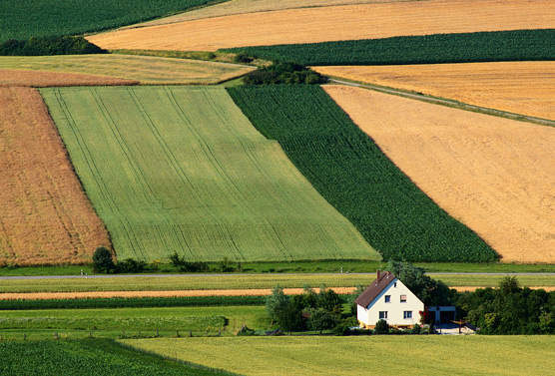
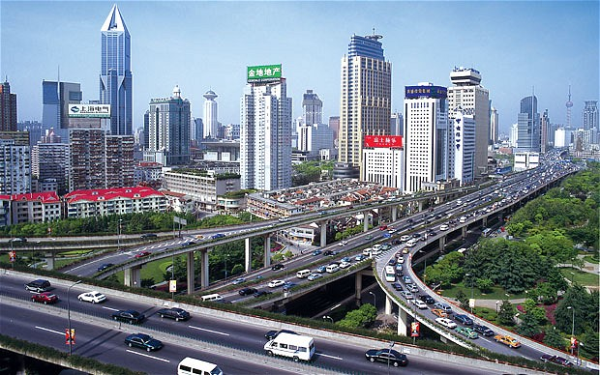
Urbanization
Is a population shift from rural to urban areas

Slide 4
Causes of Urbanization
Industrialization
Building of industry brings a need for workers
Workers need homes and infrastructure of support (grocery stores etc.)

Slide 5
Causes of Urbanization
Commercial Response to industrialization
Areas that were former colonies (like Brazil) often lagged behind industrially
They became oriented toward providing commercial services instead
Natural resources flowed out of Brazil to US and Britain and they were provided manufactured goods in exchange.

Slide 6
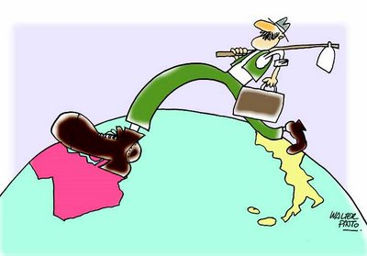
Causes of Urbanization
Migration
Desire to improve their economic position (jobs)
Lack of opportunity in Rural areas
Population pressures (too many people, not enough jobs/food)
Higher standard of living
Better educational opportunities

Slide 7
Mapping Activity
Using the map and the chart, map the top 10 Urban areas of Brazil
Then answer the two questions on the sheet

Slide 8
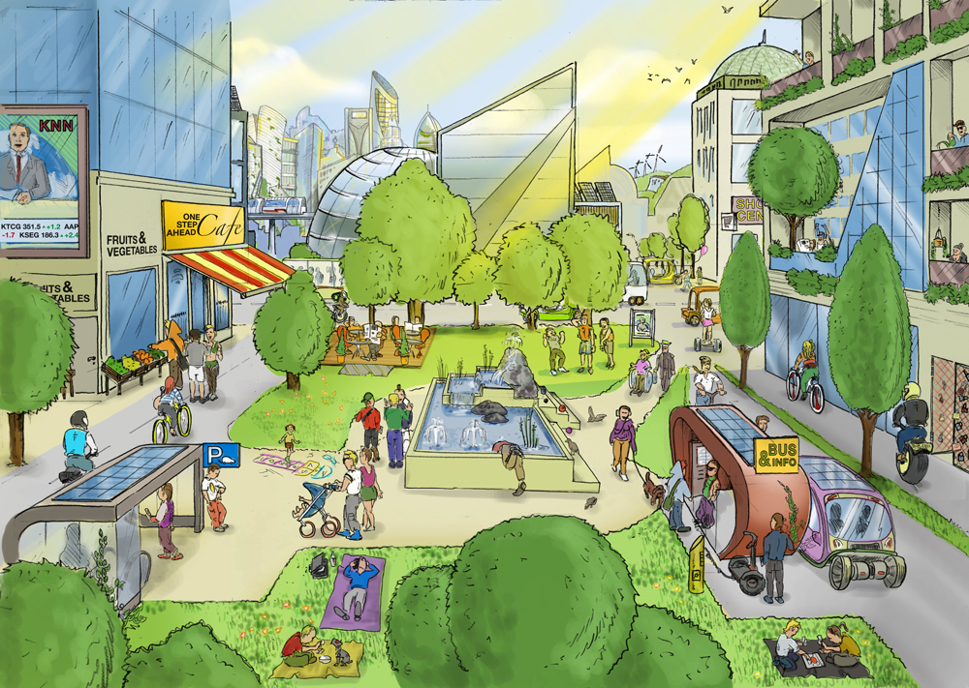
Positive Effects of Urbanization
Reduced Transport costs, exchanging ideas, sharing resources
Higher standard of living, more opportunity
Education

Slide 9
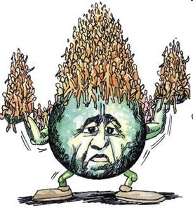
Negative Effects of Urbanization
Overpopulation-problem in accommodating the rapid growth of the cities…increase in the amount of slums.---Massive Social Inequality

Slide 10
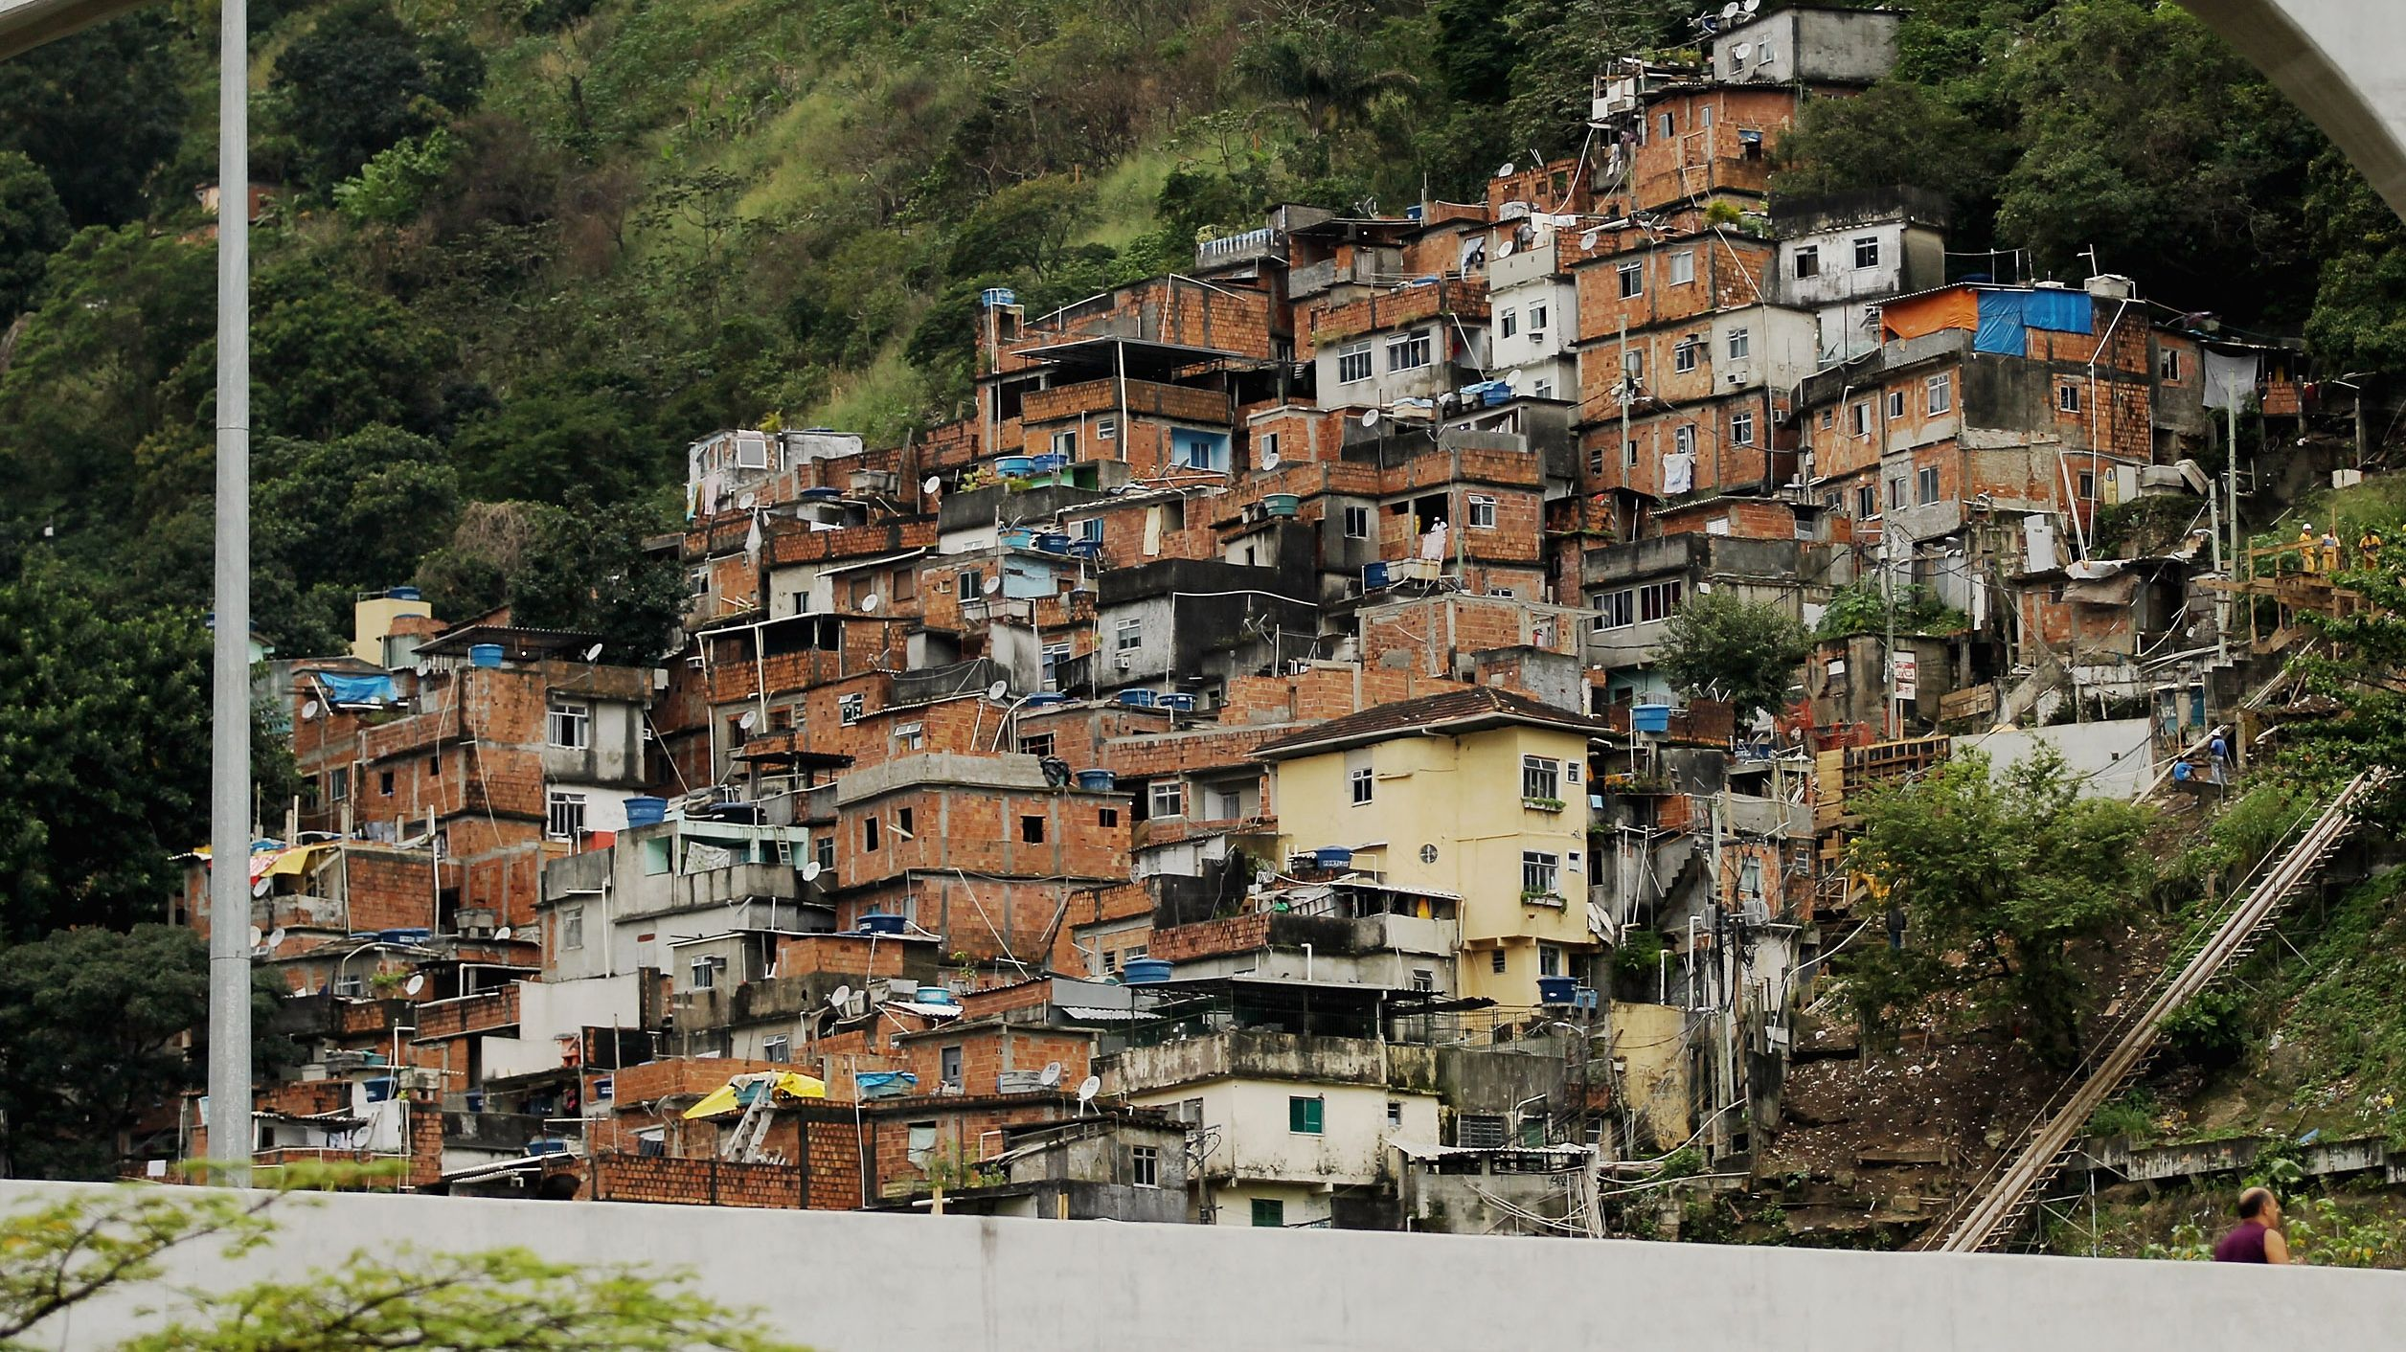

Slide 11
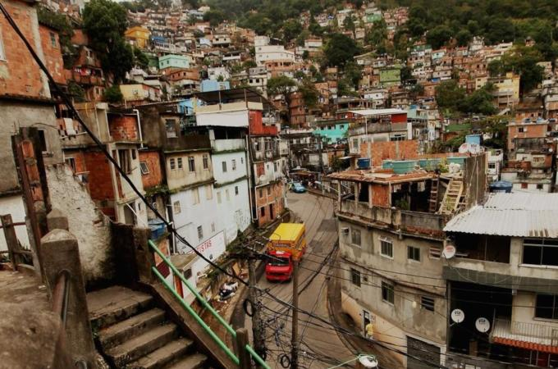

Slide 12
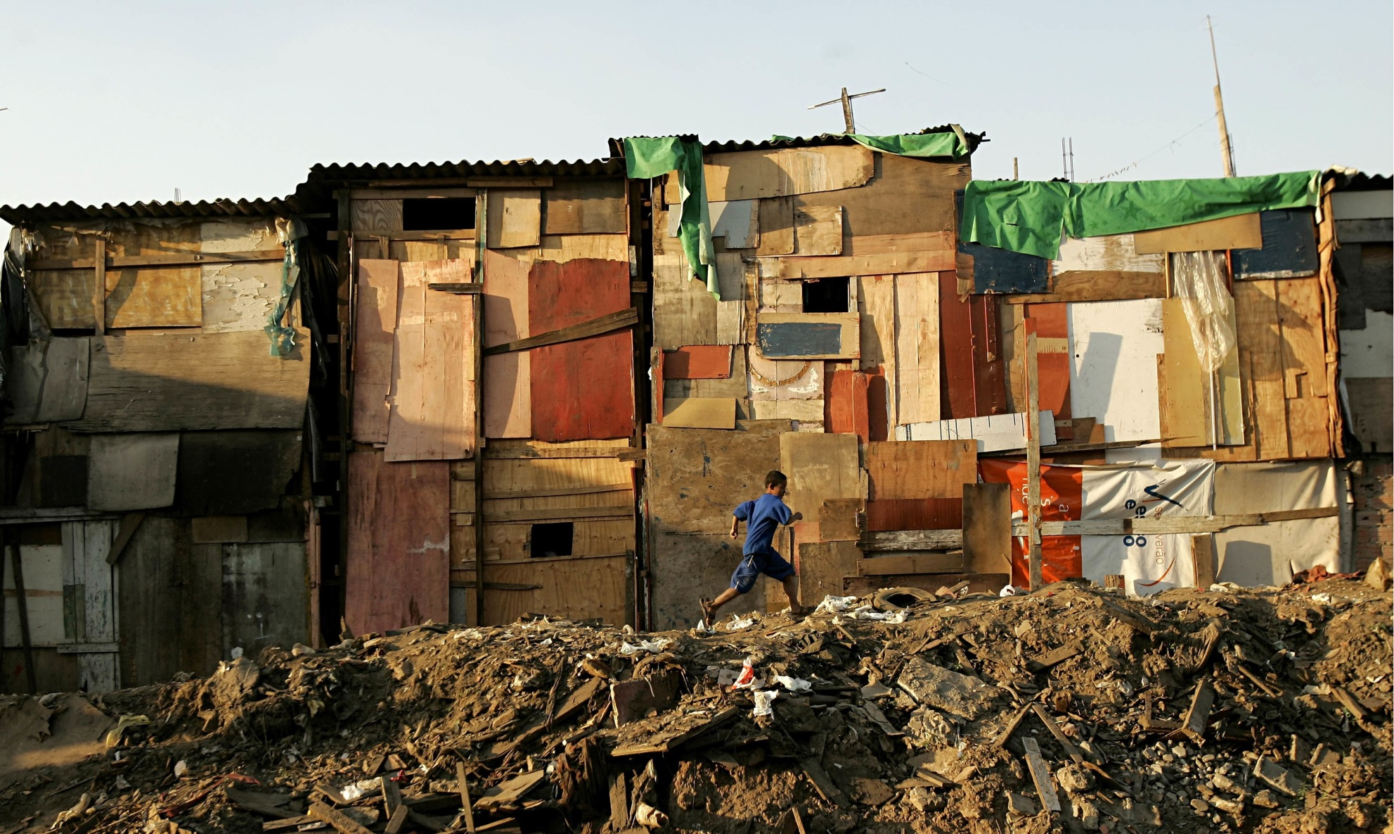

Slide 13
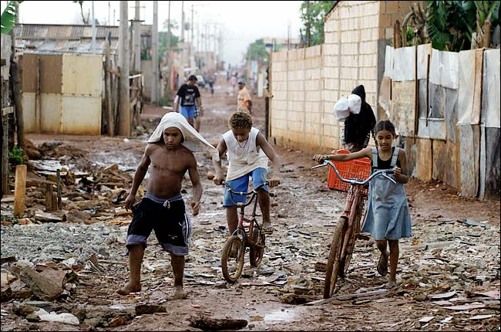

Slide 14
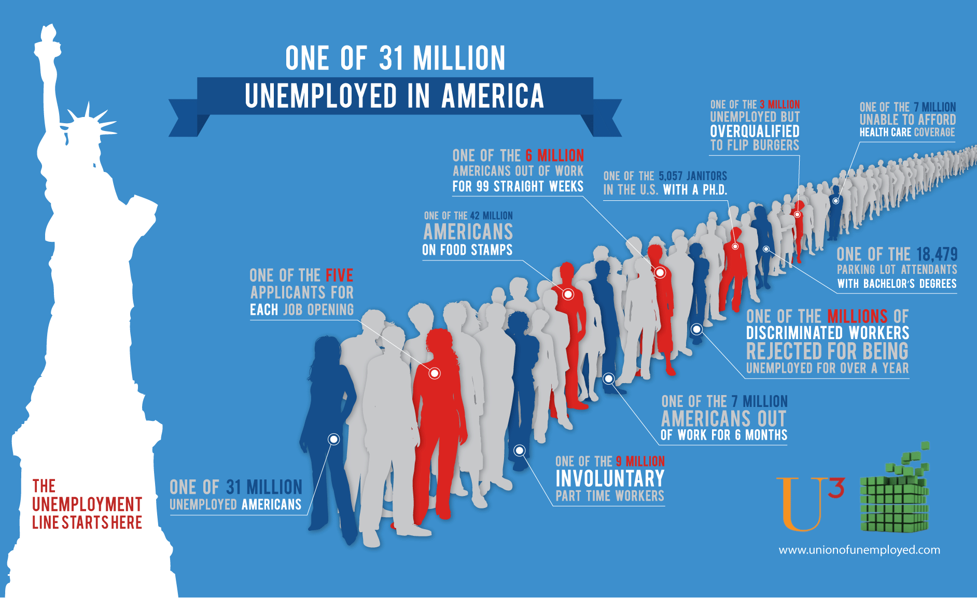
Negative Effects of Urbanization
Unemployment- poverty—turn to informal employment (street vendors, performers etc.)

Slide 15
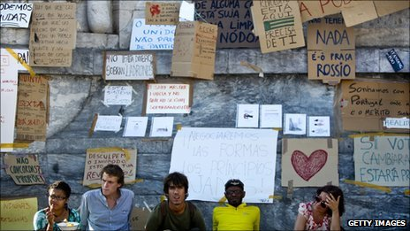

Slide 16
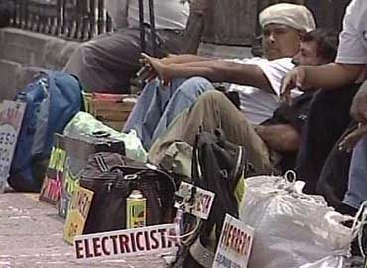

Slide 17
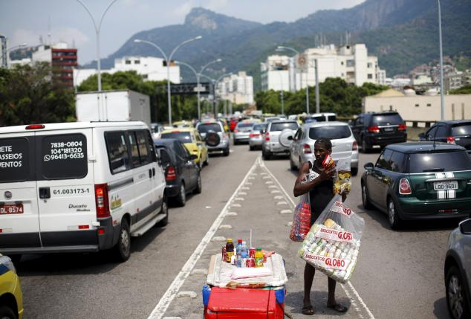

Slide 18
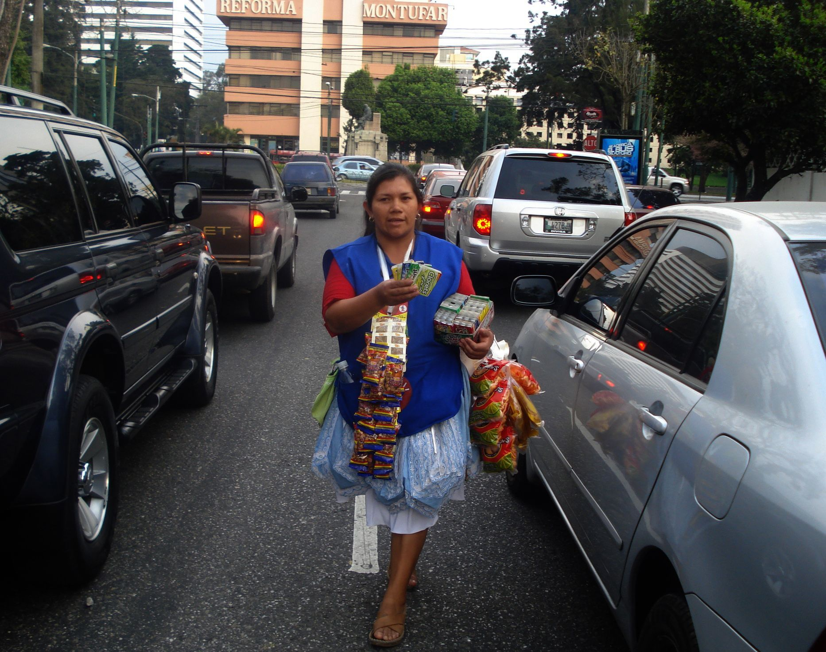

Slide 19
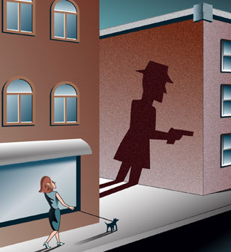
Negative Effects of Urbanization
Increase in crime rates-Theft, Murder, Cheating, Pick pocketing, rape etc. are common in urban centers.

Slide 20
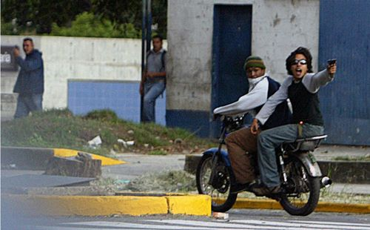

Slide 21
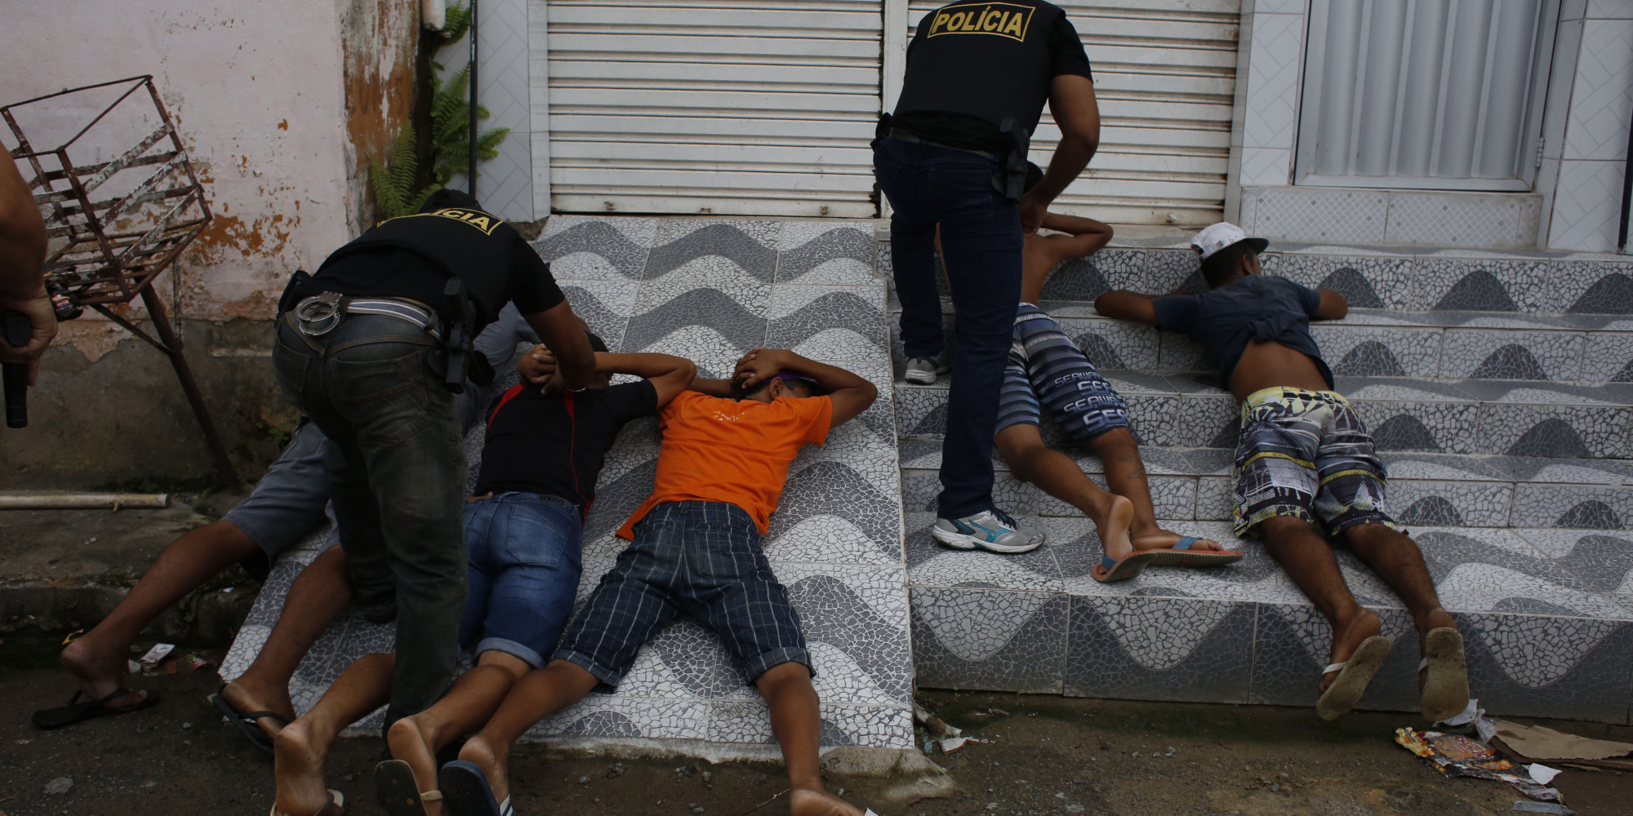

Slide 22
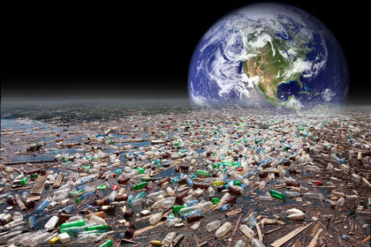
Negative Effects of Urbanization
Pollution-It may be caused by industries or by excessive movement of vehicles.

Slide 23
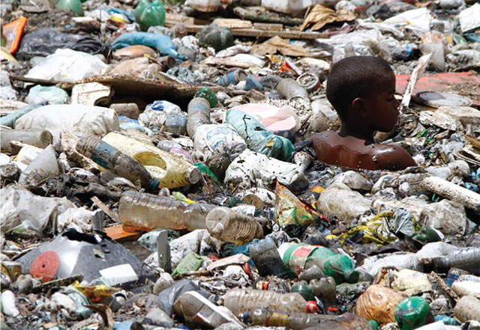

Slide 24
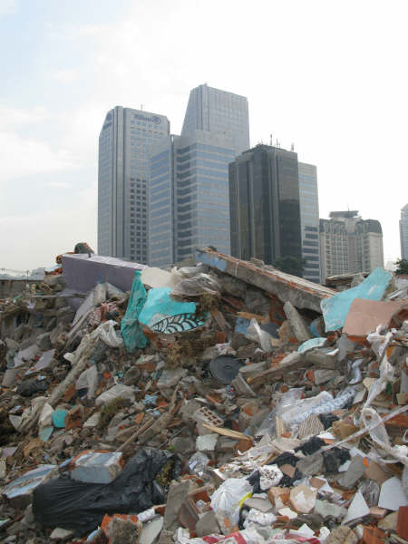

Slide 25
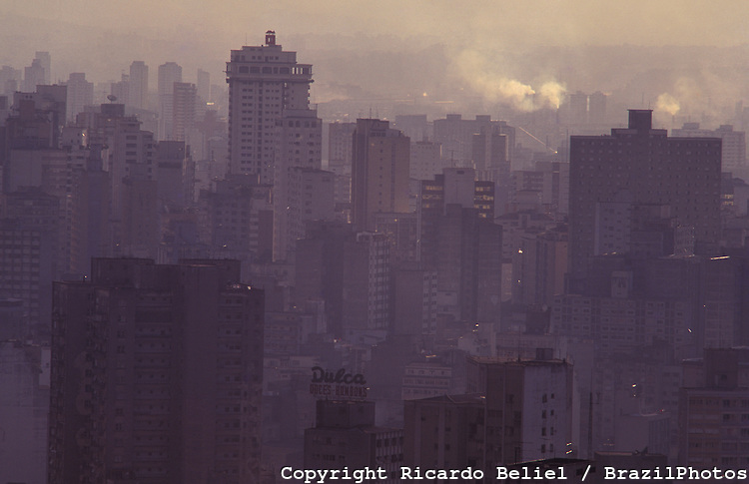

Slide 26
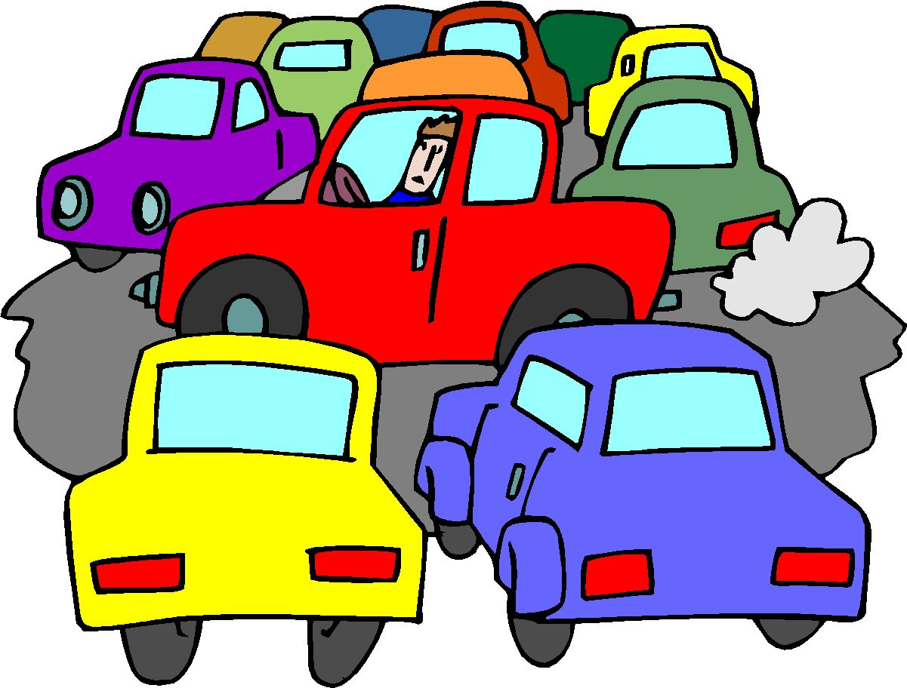
Negative Effects
Transportation- Increase amount of traffic and lacking public transportation

Slide 27
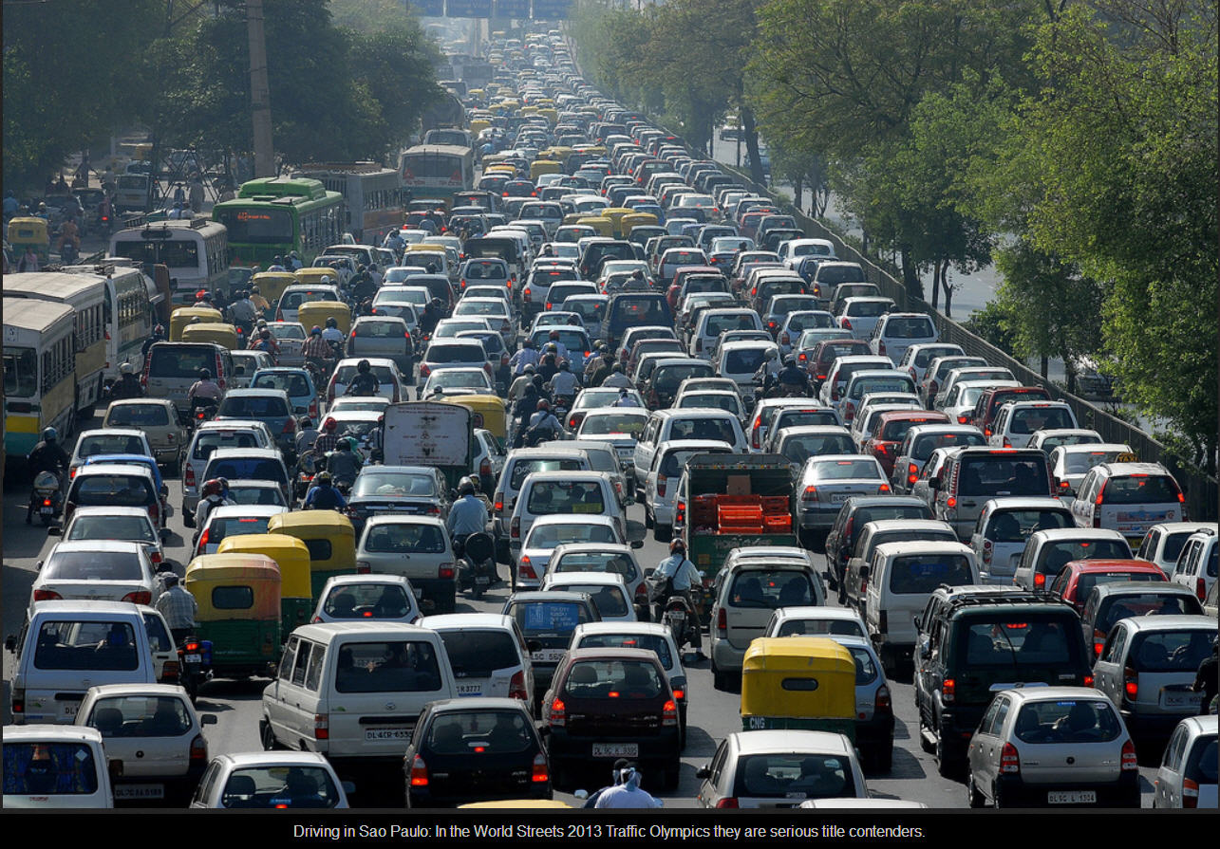

Slide 28
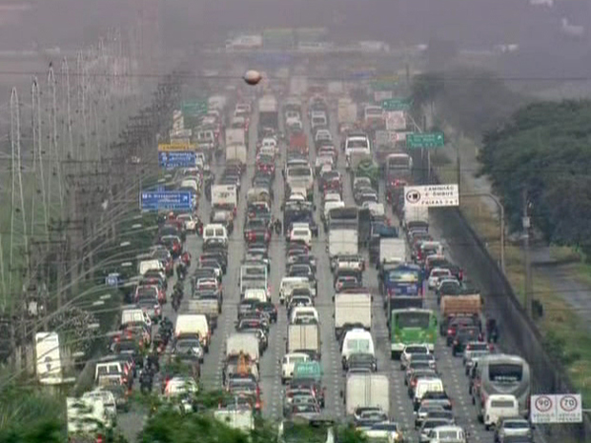

Slide 30
Thinking Ahead
Pick a problem of Urbanization and brainstorm several solutions that you can think of to solve the problem in a graphic organizer.
Possible Solution
Possible Solution
Problem caused by Urbanization
Possible Solution
Possible Solution

