Slide 1
The Calamitous 14th Century
The End of the Middle Ages!

Slide 2
The Black Death
1347-1351

Slide 3
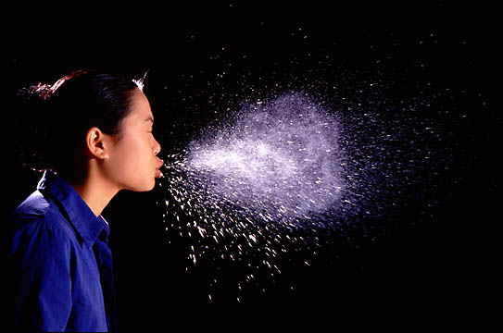
Here a Germ, There a Germ

Slide 4
Medieval Towns
“The filth from the [first floor] toilets fell onto the heads of the passers-by”-Court records 1321
“The floors of the houses are. . . .a mixture of beer, grease, bones, and the body waste of men and animals.” -A foreigner visiting London

Slide 5
Medieval Towns
Prime conditions for the spread of disease
Very crowded
Very dirty
Did not bathe, threw waste out into the street.
Medical “experts” were Unprepared and unknowledgeable

Slide 6
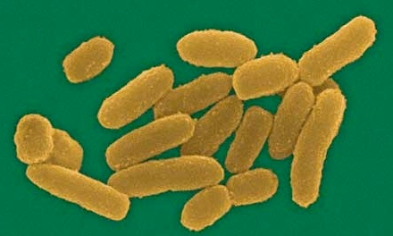
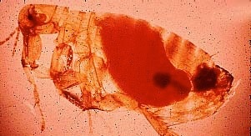
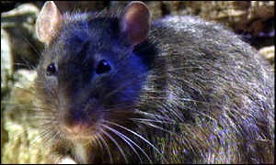
The Culprits

Slide 7
A Rat’s life
Clip

Slide 8
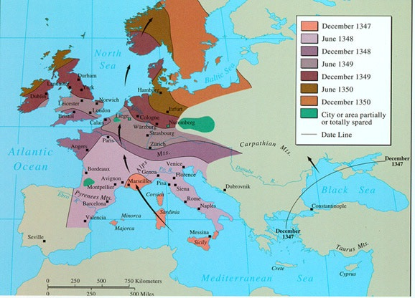
Where did it come from?

Slide 9
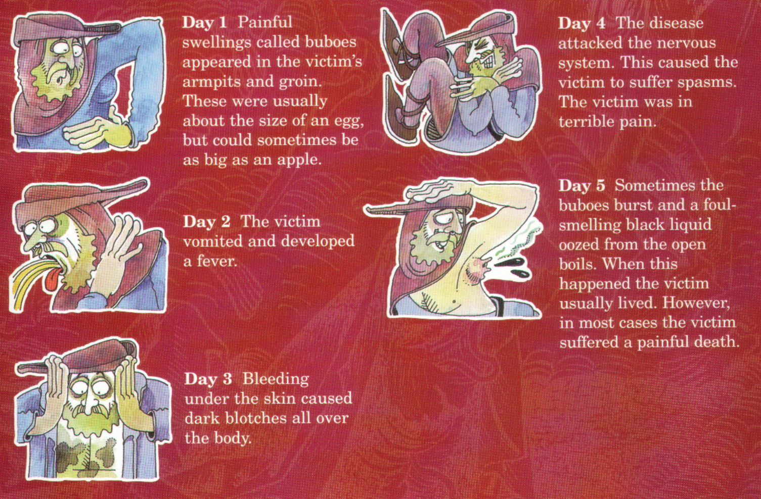
Symptoms

Slide 10
Cures
Medieval people didn’t know about the germs causing the disease. They didn’t realize it was due to uncleanliness, rats, or fleas.

Slide 11
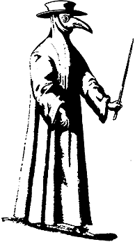
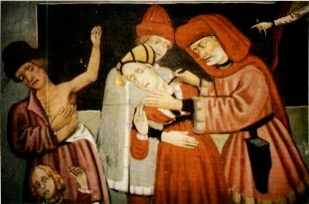
Attempts to Stop the Plague
“Leeching”
A Doctor’s Robe

Slide 12
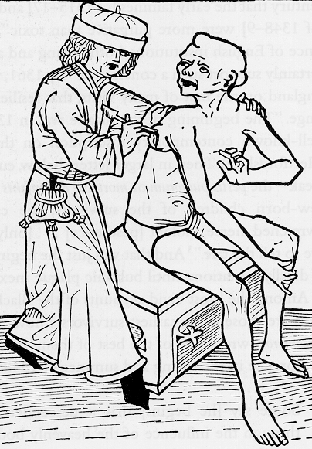
Lancing a Buboe

Slide 13
Cures
“Don’t Bathe”- belief the plague was contracted through pores. . .bathing opened the pores---oops!
Bloodletting
sit in a sewer. . .idk maybe the bad smell will chase the disease away

Slide 14
Cures
Drink your own urine...mmmmm
Pray to God. . .perhaps you got the plague because of your sin!

Slide 15
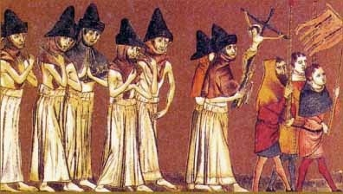
Attempts to Stop the Plague
Flagellanti: Self-inflicted “penance” for our sins!

Slide 16
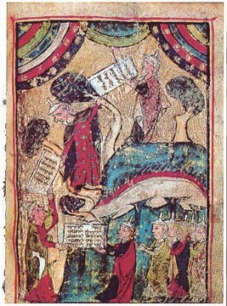
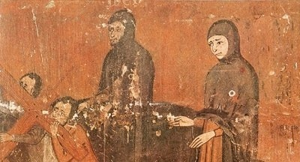
Attempts to Stop the Plague
Pograms against the Jews
“Golden Circle” obligatory badge
“Jew” hat

Slide 17
What were the political, economic, and social effects of the Black Death??

Slide 18
The Mortality Rate
35% - 70%
25,000,000 dead !!!

Slide 19
Effects
“father abandoned child, wife abandoned husband, one brother abandoned another, for the plague seemed to strike through breath and sight. And so they died. And no one could be found to bury the dead, for money or friendship.” (Boccoccio)

Slide 20
Effects
Trade declined
Shortage of workers (town populations decline)
Rise in the price of labor
Lowered demand for food=falling prices

Slide 21
Effects
Church lost prestige (prayers and penance failed to stop the plague)
Complete disillusionment in the church and it’s leaders.
God was punishing the people

Slide 22
Effects
Art and literature reflect the awareness of death
Sought pleasure and self- indulgence
“Eat, Drink, and be Merry for tomorrow you may die!” the original YOLO

Slide 23
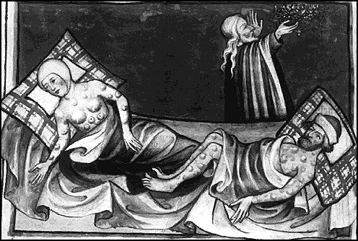
From the Toggenburg Bible, 1411

Slide 24
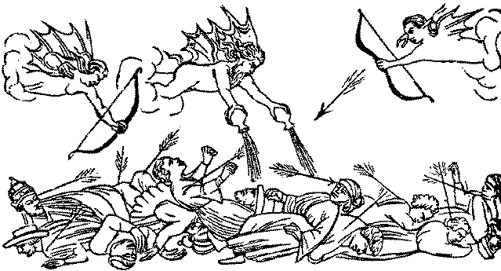
Medieval Art & the Plague

Slide 25
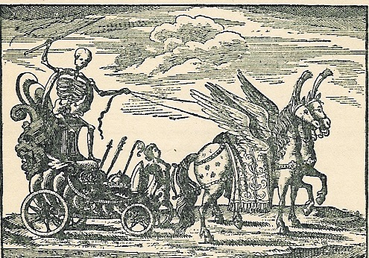
Death Triumphant !: A Major Artistic Theme

Slide 26
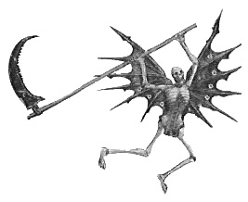
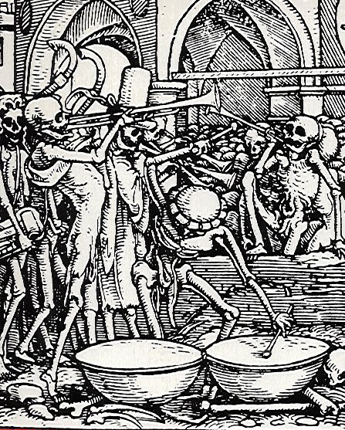
Medieval Art & the Plague
An obsession with death.

Slide 27
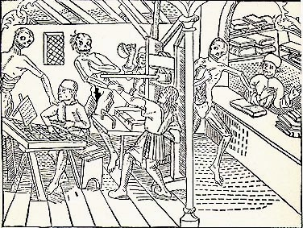
The Danse Macabre

Slide 28
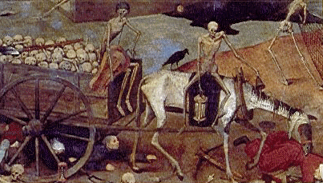
Medieval Art & the Plague
Bring out your dead!

Slide 29
Peasant Revolts
Due to the labor shortage (plague) lords wanted peasants to work more
Peasants wanted more money
Peasants begin to burn houses and fields in protest

Slide 30
The Great Schism

Slide 31
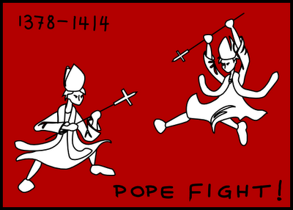
Popes move to Avignon
A French pope is chosen (pressured by the French king)
Pressured to move the papacy to France (72 years!)
The pope was eventually persuaded (by a woman) to return to Rome, but he dies shortly after.

Slide 32
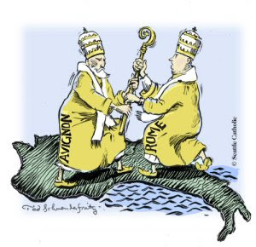
Problems increase
After death of pope citizens in Italy were fearful of another French pope who would move back to France.
Fearfully elected an Italian Pope=promised to reduce French influence
French cardinals leave Rome and elect their own Pope (2 popes!!)

Slide 33
Resolution
Council meets- deposes both popes and elects a new one—but the previous two do not step down
2nd council- deposes ALL three popes and elects a Roman Cardinal—Great Schism was over
Results: Popes did not have the same amount of power, and councils met regularly to discuss changes in church
Disillusionment in the church…people began questioning the establishment.

Slide 34
Hundred Years’ War
1337-1453

Slide 35
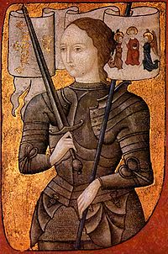
England Vs. France
Began over disputes over land in France held by England
Use of the long bow-end of chivalry
Joan of Arc
Rise of Nationalism-end of Feudalism

Slide 36
End of the Middle Ages
Plague and Great Schism marked the end to the Age of Faith
Hundred Years' War marked the end to the Age of Chivalry and the Age of Feudalism.
That which characterized the Middle Ages ended. Thus marking the end of the Middle Ages.

Slide 37
Legacy
Inventions and innovations:
Saddle, stirrup, horse harness, 3-field system,
fairs and guilds (trade)
Epic poetry
Gothic Cathedrals
Vernacular (universities)

