Slide 1
Imperialism Motivations

Slide 2
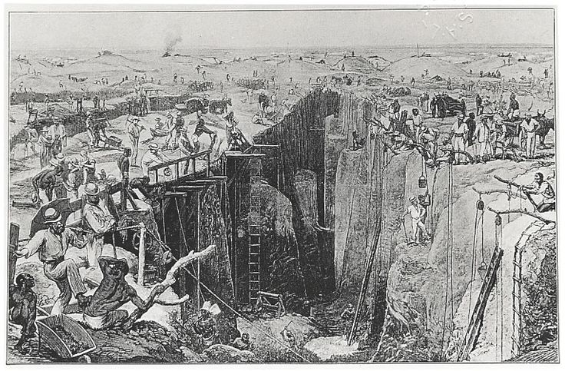
A. Open-shaft diamond mining at Kimberly, South Africa, 1872

Slide 3
B.

Slide 4
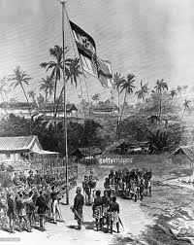
C.
Germans taking possession of Cameroon, 1881

Slide 5
D.
As yet the Congo basin is a blank, a fruitless waste, a desolate and unproductive area….It has been our purpose to fill this blank with life, to redeem this waste, to plant and sow that the dark man may gather, to vivify the wide, wild lands so long forgotten by Europe. But cursed be he or they who, animated by causeless jealousy and a spirit of jealousy and a spirit of mischief, will compel us to fire our station, destroy our work so conspicuously begun, and abandon Africa to its pristine helplessness and savagery.
--Henry Stanley, 1882

Slide 6
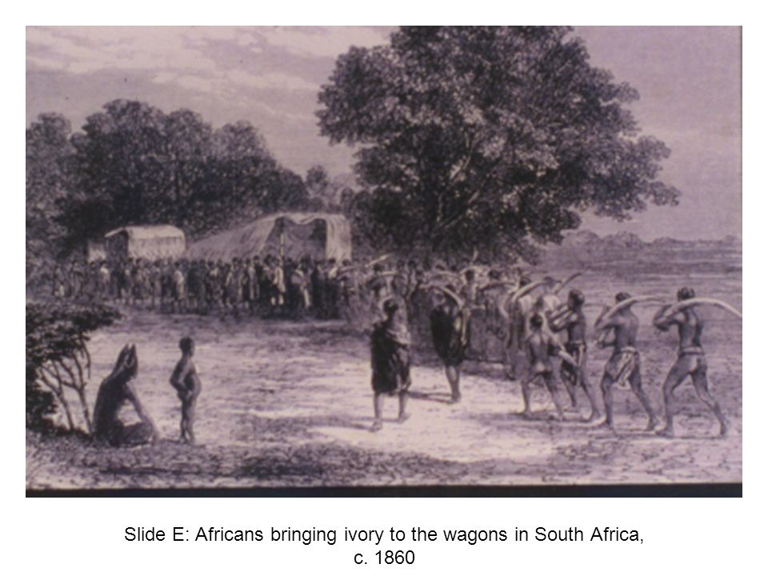

Slide 7
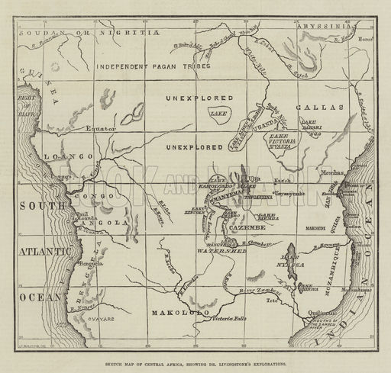
F.
Sketch map of Central Africa, showing Dr. Livingstone’s exploration

Slide 8
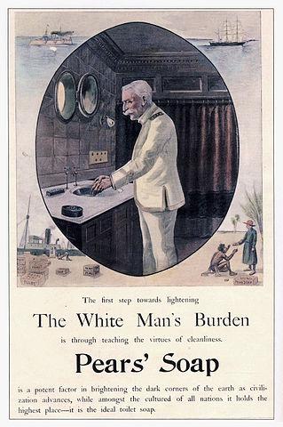
G. Advertisement for Pear’s Soap 1890s
Excerpt from The White Man’s Burden:
Take up the White Man’s Burden
Send forth the best ye breed
Go bind your sons to exile
To serve your captives’ need;
To wait in heavy harness
On fluttered fold and wild
Your new-caught sullen peoples,
Half-Devil and half-child.
-Rudyard Kipling, 1899

Slide 9
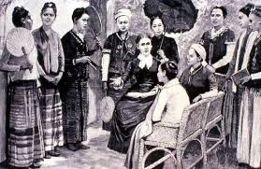
H. Mrs. Maria C. Douglas, doctor and missionary, and the first class of pupil nurses in Burma, 1888

Slide 12
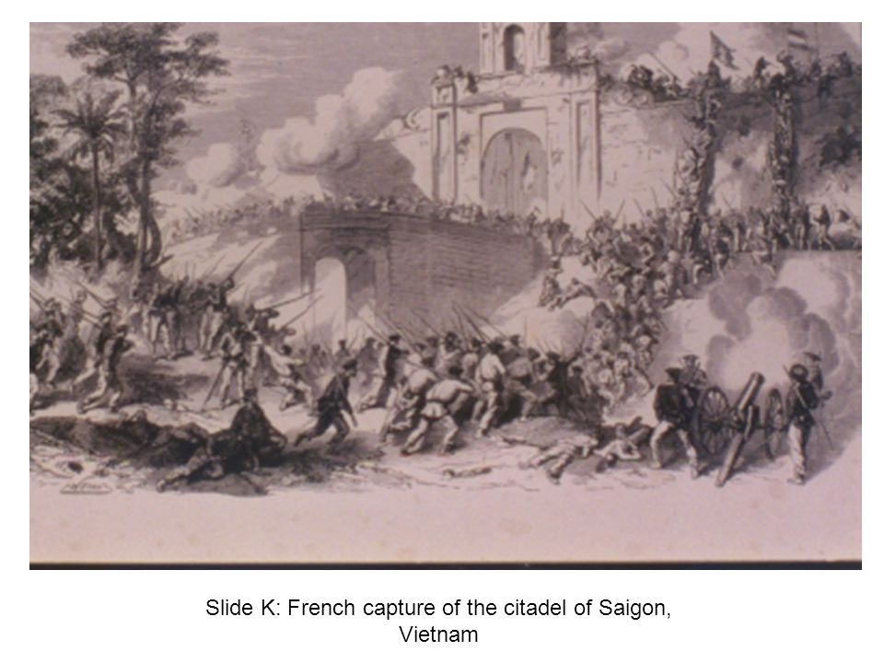

Slide 13
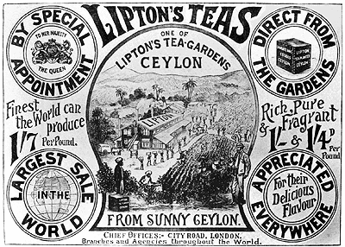
L. British Lipton Tea advertisement, 1890s

Slide 14
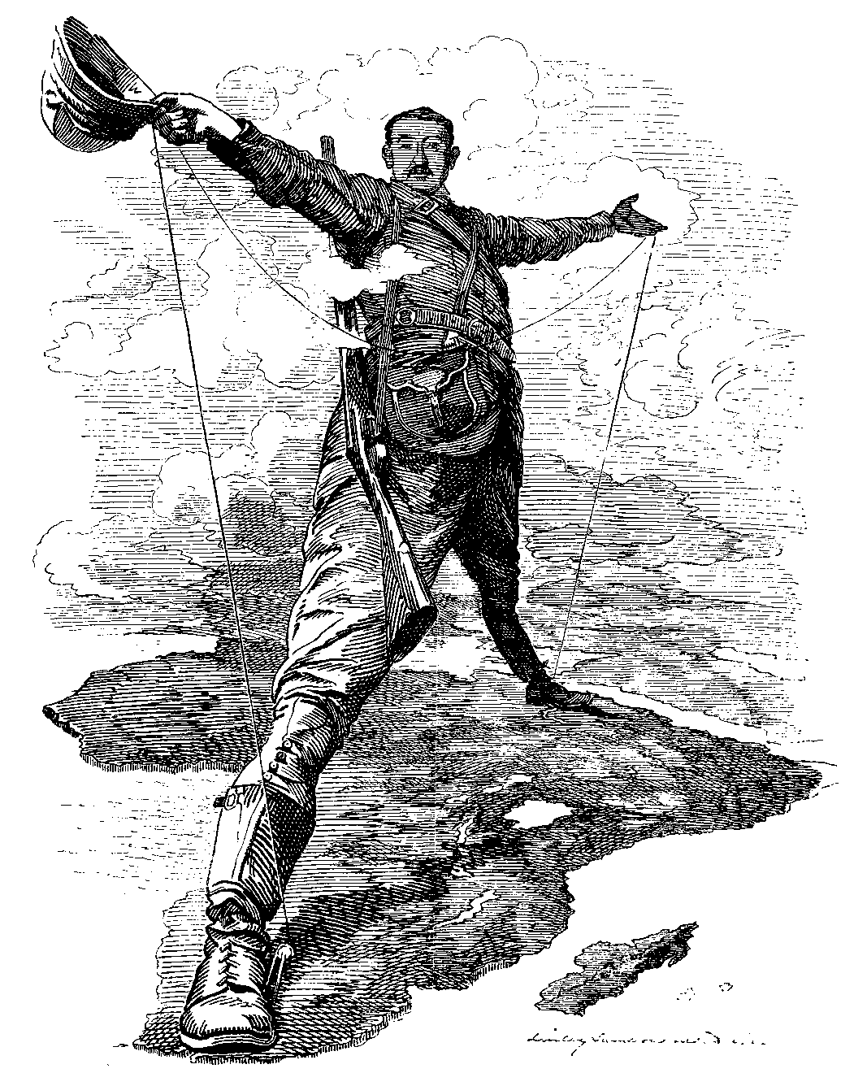

Slide 15
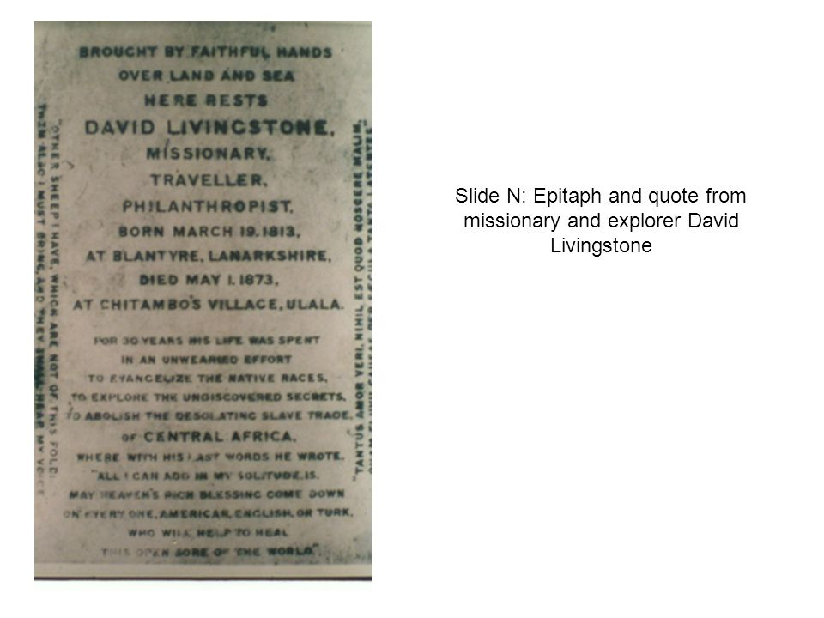
I beg to direct your attention to Africa; I know that in a few years I shall be cut off in that country, which is now open: Do not let it be shut again! I go back to Africa to try to make an open path for commerce and Christianity; do you carry out the work which I have begun. I leave it with you!
--David Livingstone, 1857

Slide 16
