Slide 1
Climate

Slide 2
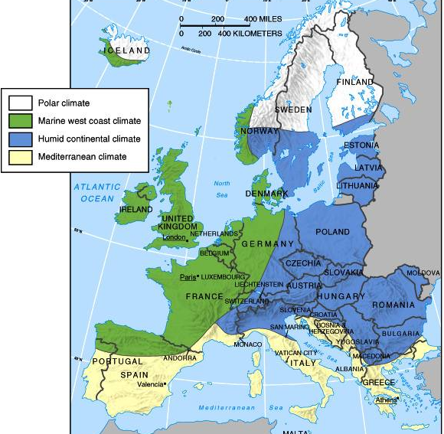
Climate

Slide 3
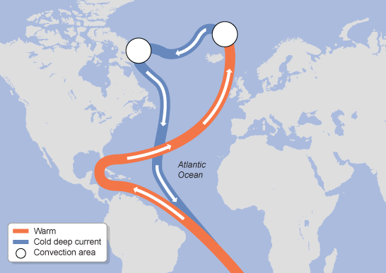
North Atlantic Drift

Slide 4
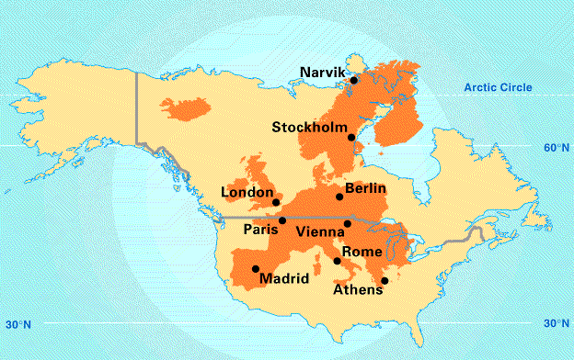
Europe’s Latitude v. US

Slide 5
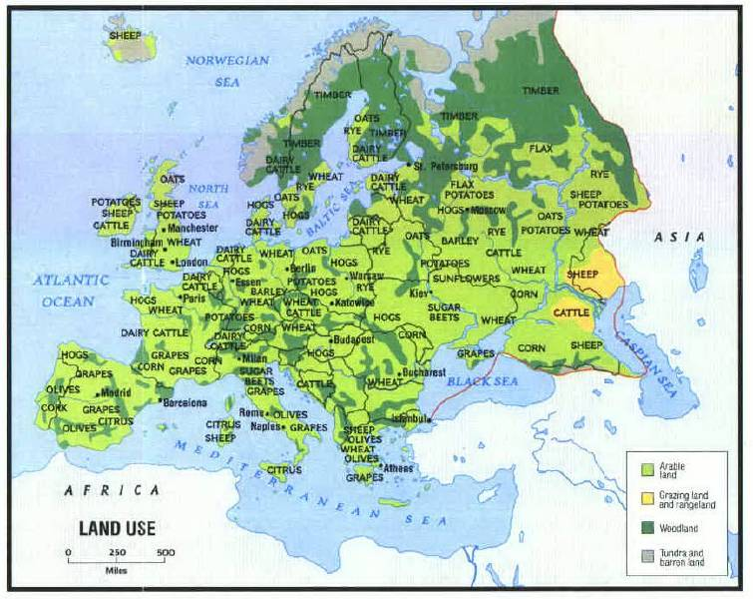
L a n d
U s e

Slide 6
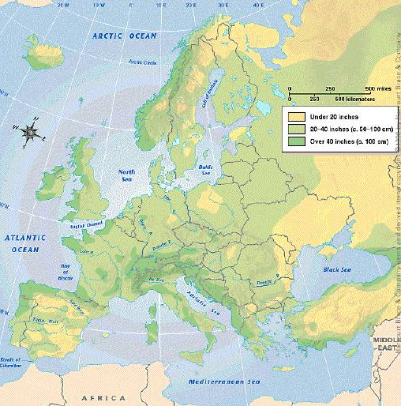
Average Annual Precipitation

Slide 7
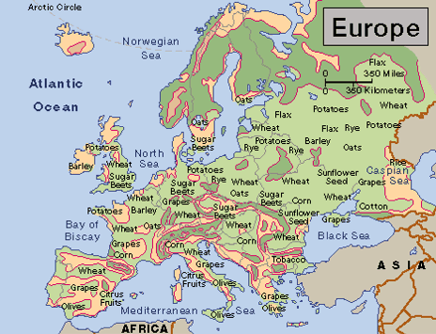
Agricultural Activity

Slide 8
Natural Resources

Slide 9
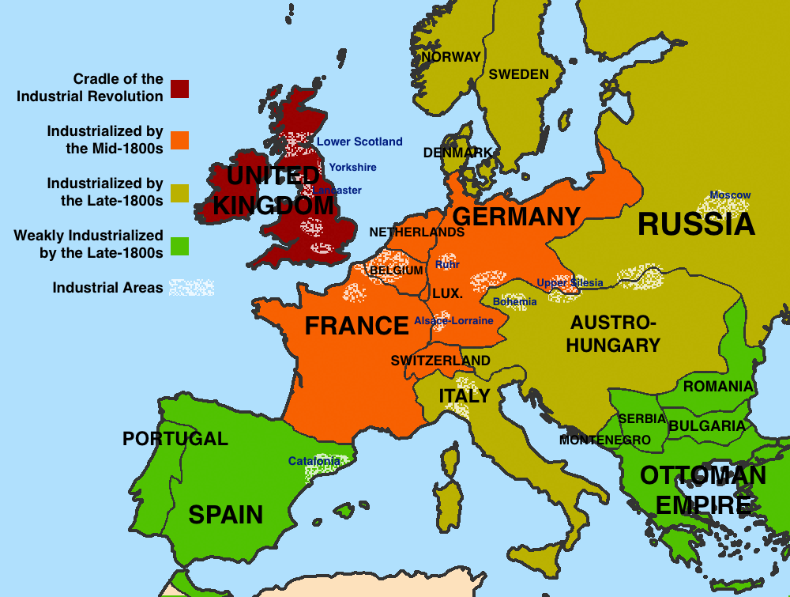
Industrialization

Slide 10
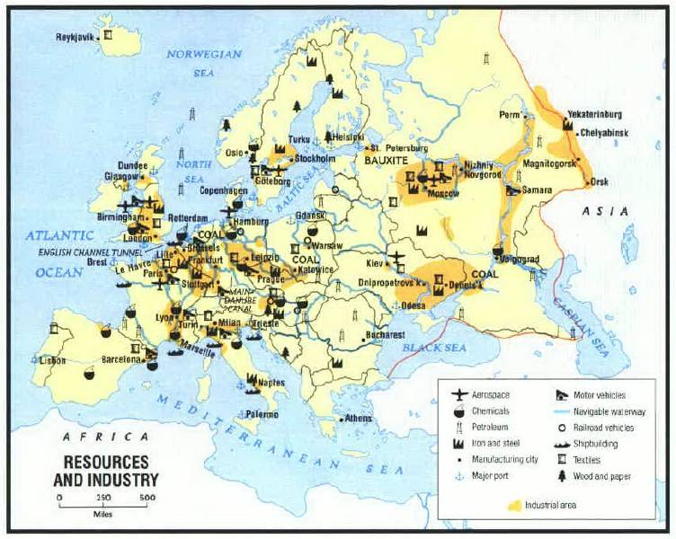
R E S O U R C E S

Slide 11
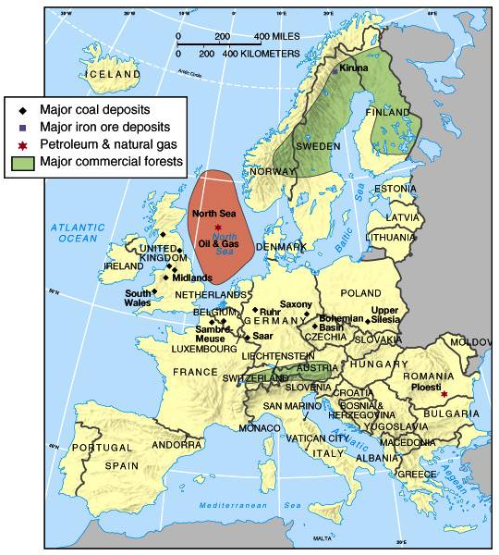
Major Industrial Resources

Slide 12
Geographic
Problems

Slide 13
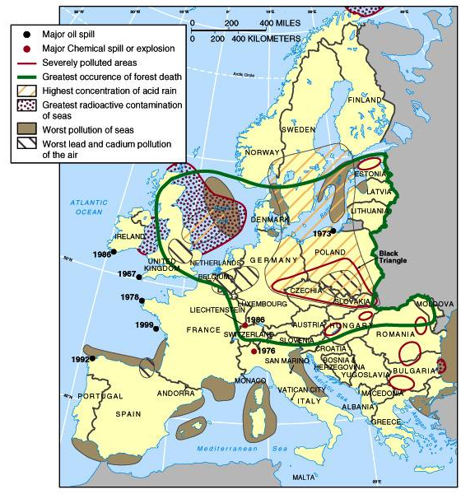
Major Environmental Disasters & Pollution Problems

Slide 14
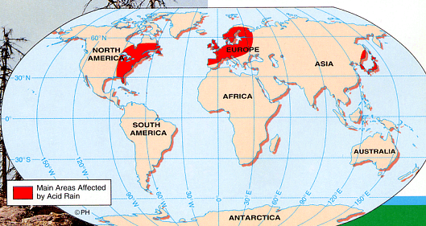
Acid Rain

Slide 15
Demographics

Slide 16
World Population by Continents
Asia | 3,737,000,000
Africa | 823,000,000
Europe | 729,000,000
North America | 486,000,000
South America | 351,000,000
Oceania (incl. Australia) | 31,000,000
Antarctica | no permanent population

Slide 17
Population Density [People Per Square Mile]
Belgium | 336.82 |  | Mexico | 52.15
Japan | 336.72 |  | United States | 29.77
India | 336.62 |  | World | 14.42
United Kingdom | 244.69 |  | Norway | 14.42
Italy | 192.96 |  | Canada | 3.36
France | 108.09 |  | Russia | 8.61

Slide 18
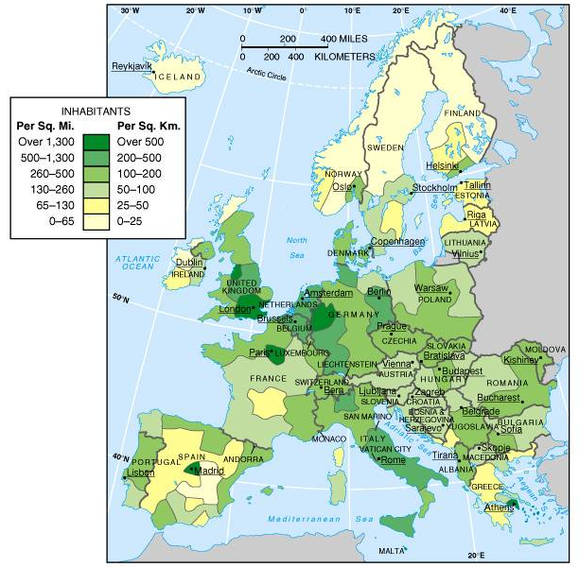
Population Distribution

Slide 19
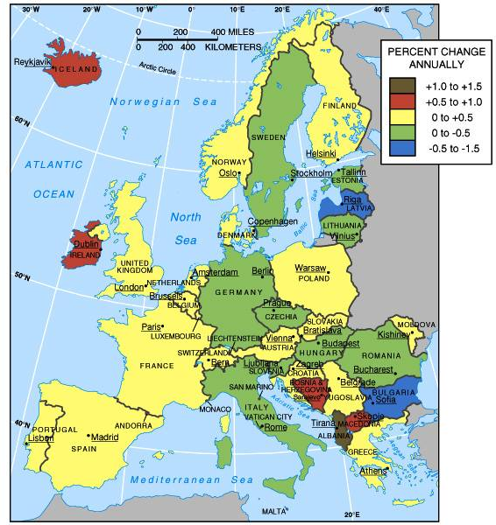
Population Growth

Slide 20
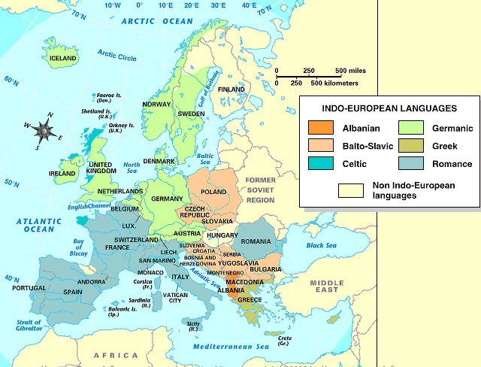
Members of the Indo-European Language Family

Slide 21
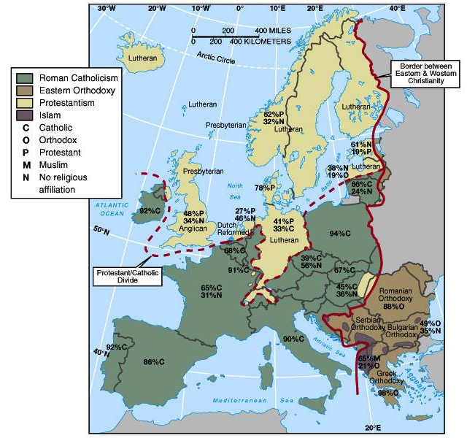
Major Religious Groups in Europe

Slide 22
Europe History

Slide 23
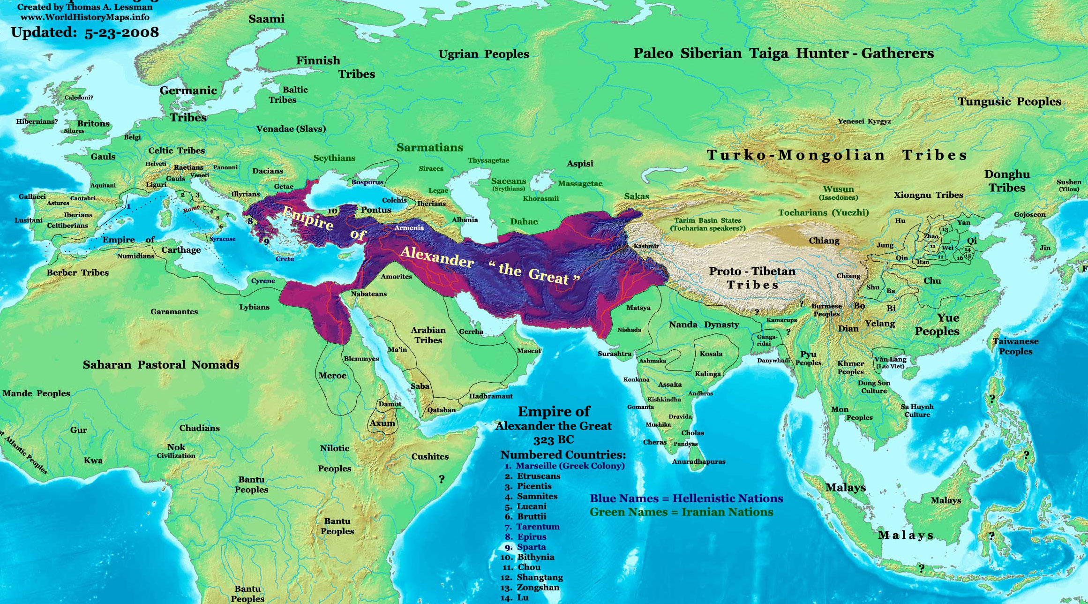
Europe: Alexander the Great 324BCE

Slide 24
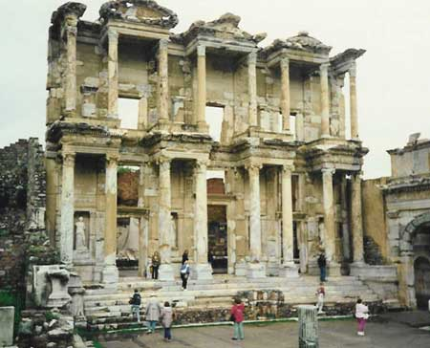

Slide 25
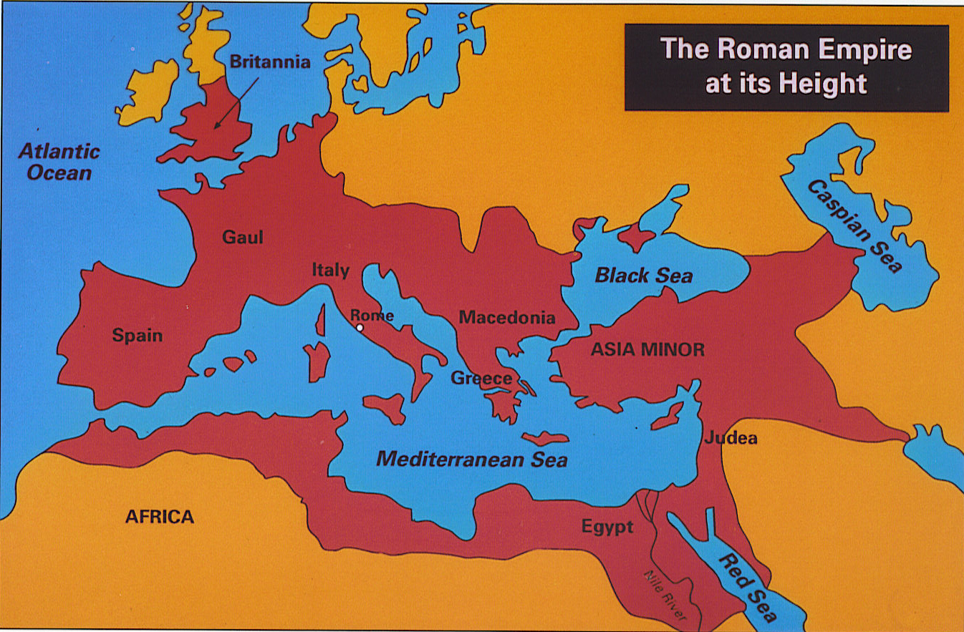
Roman Empire

Slide 26
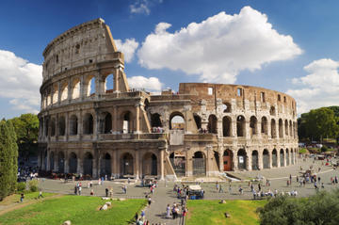
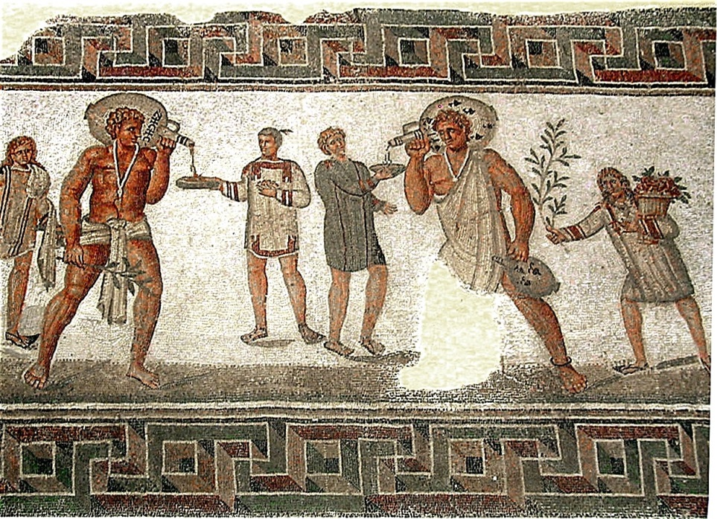
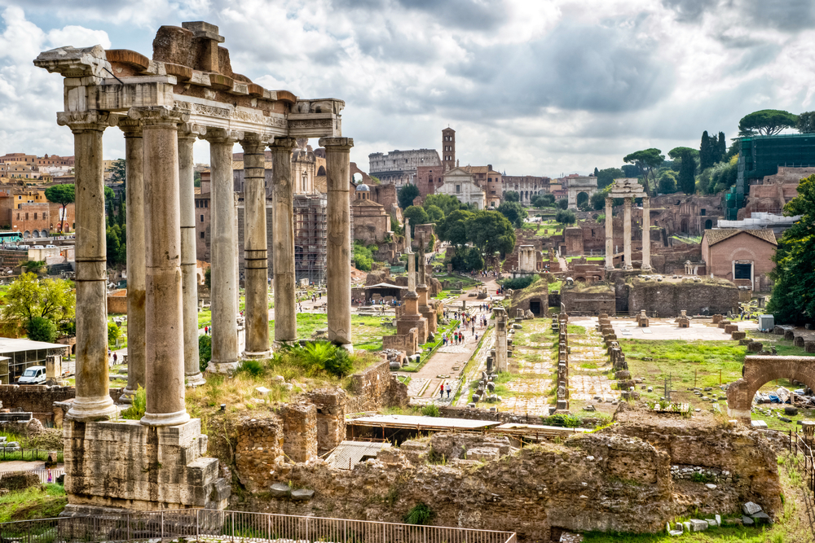

Slide 27
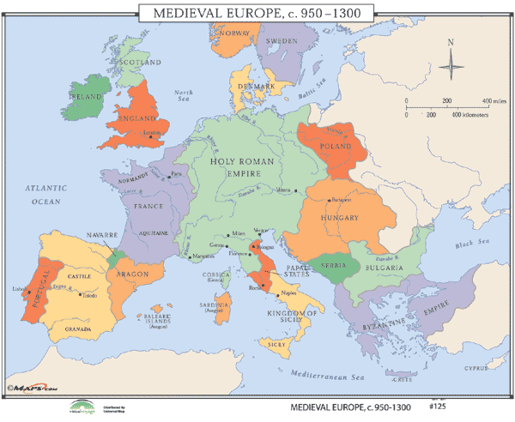
Medieval Europe

Slide 28
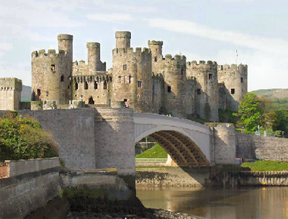
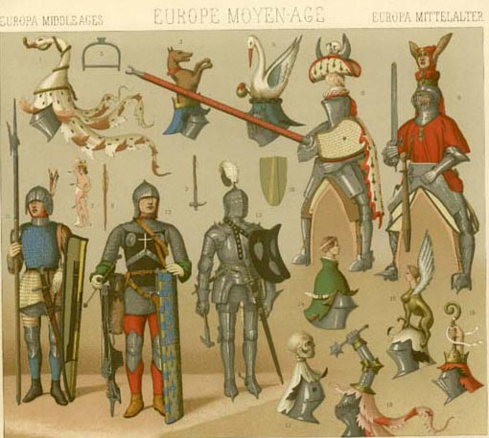
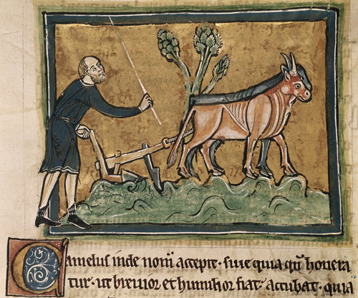

Slide 29
Industrialization

Slide 30
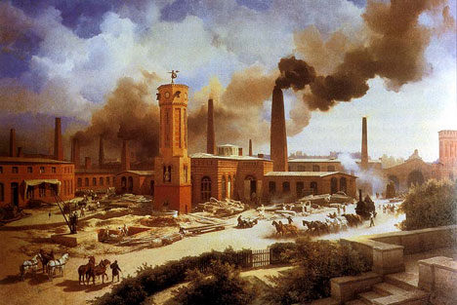
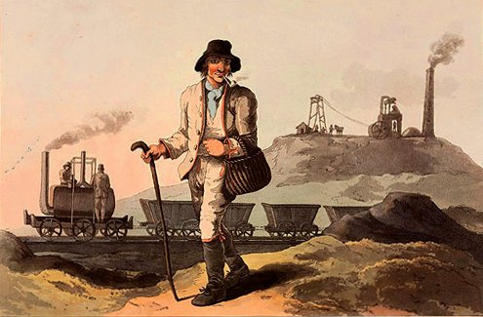

Slide 31
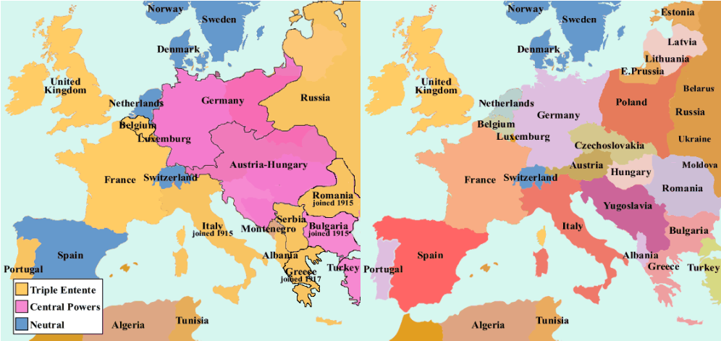
WWI

Slide 32
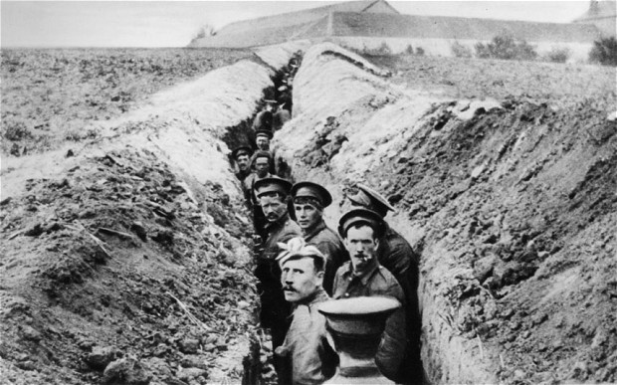
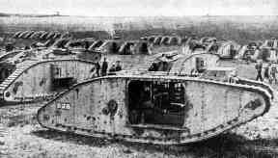
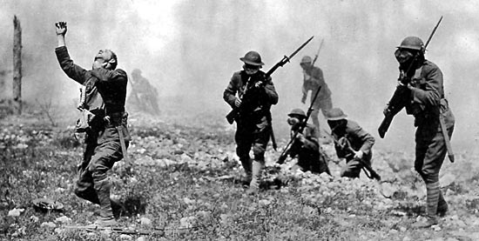

Slide 33
WWII
https://www.youtube.com/watch?v=lm5SxG68KSM

Slide 34
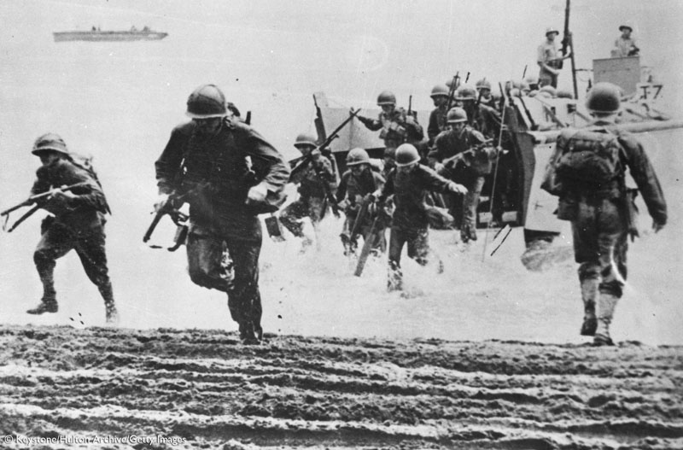
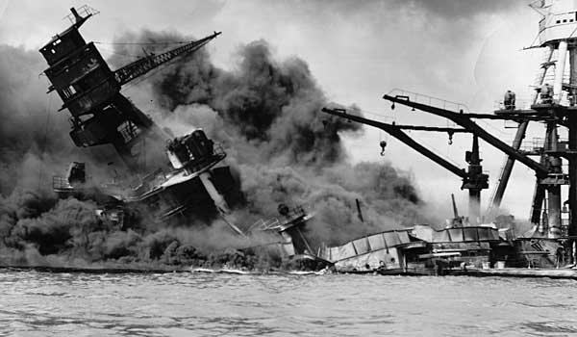

Slide 35
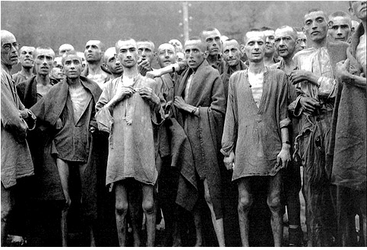
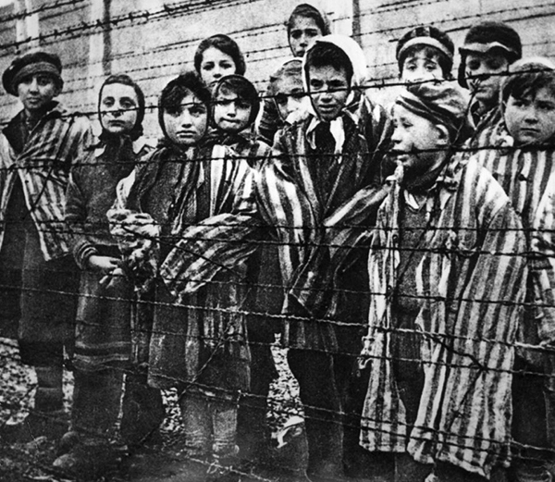

Slide 36
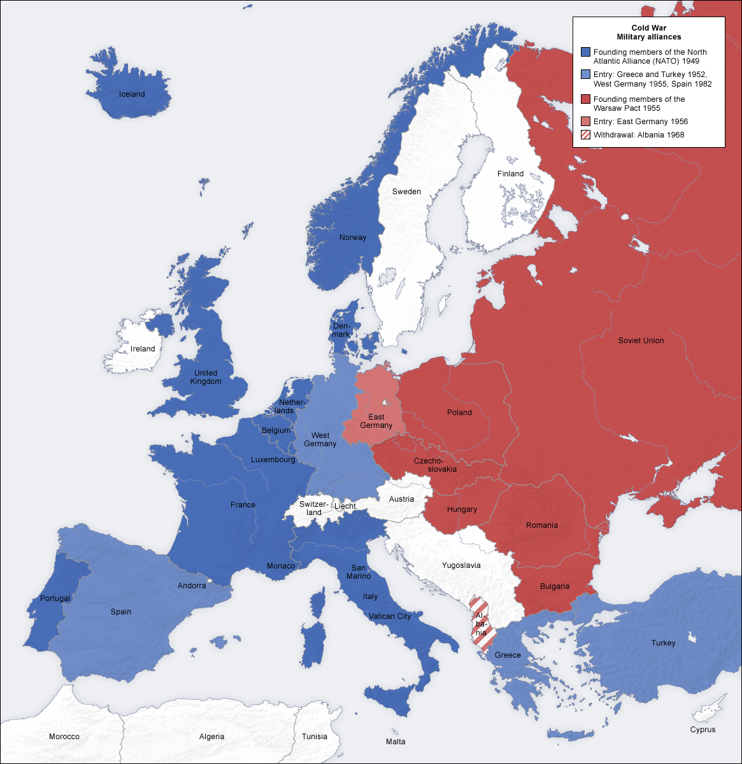
Cold War

Slide 37
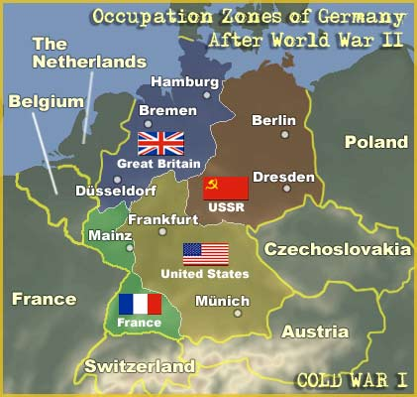
Germany Cold War

Slide 38
