Slide 1
Dutch Door Book Construction

Slide 2
Measure 4 ½ inches from fold and cut, Cut along fold as well

Slide 3
After cutting, you should have 8 pieces that look like this

Slide 4
Set these pieces aside for your front and back cover

Slide 5
Set these pieces aside as well. The two covers and these three pieces will be for your first five “required” project parts (Part 1)

Slide 6
Take the remaining 3 pieces and fold down. Then cut along the fold to get 6 half pages. These will be for each of the choice project parts (Part 2 and 3)

Slide 7
Hole Punching your book

Slide 9
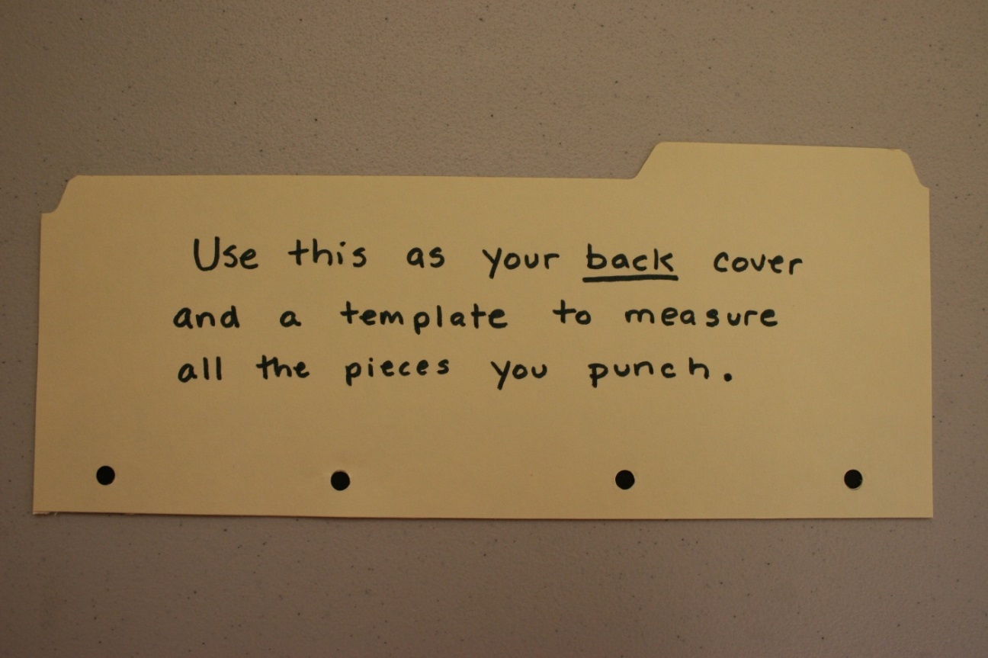
Use the first page you punch as a guide for the next pages, so you don’t have to measure each time

Slide 11
You can arrange your pages however you like here are some choices

Slide 13
Tying your book together

Slide 14
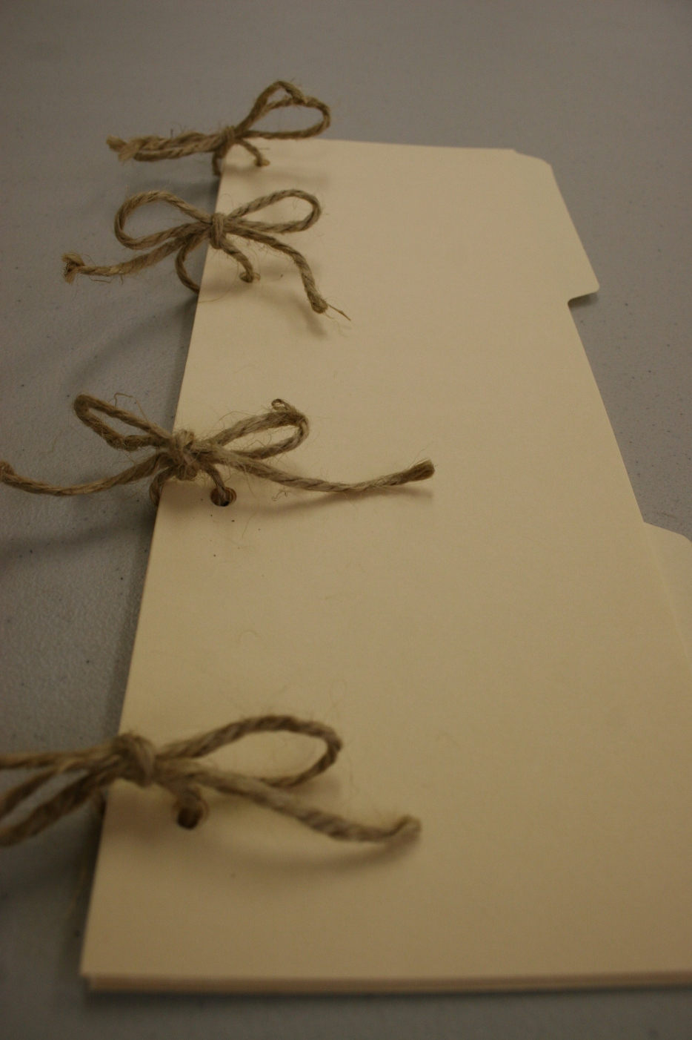

Slide 15
Making Label Tabs

Slide 16
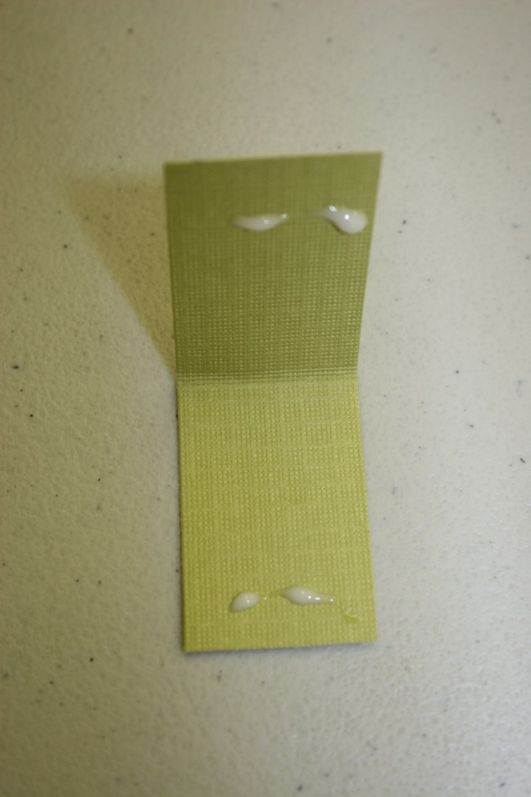

Slide 18
What your book should somewhat look like when you finished

Slide 19
Add creative flair to make it aesthetically pleasing to the eye-balls

