Slide 1
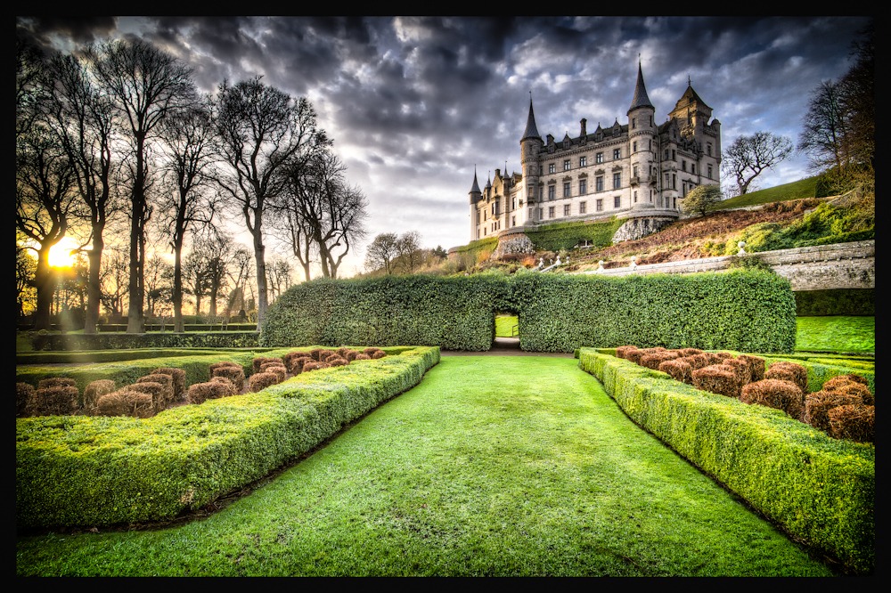
New Monarchies & Absolutism

Slide 2
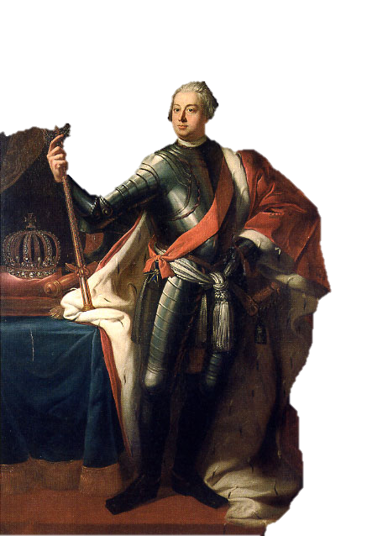
Absolutist Prussia

Slide 3
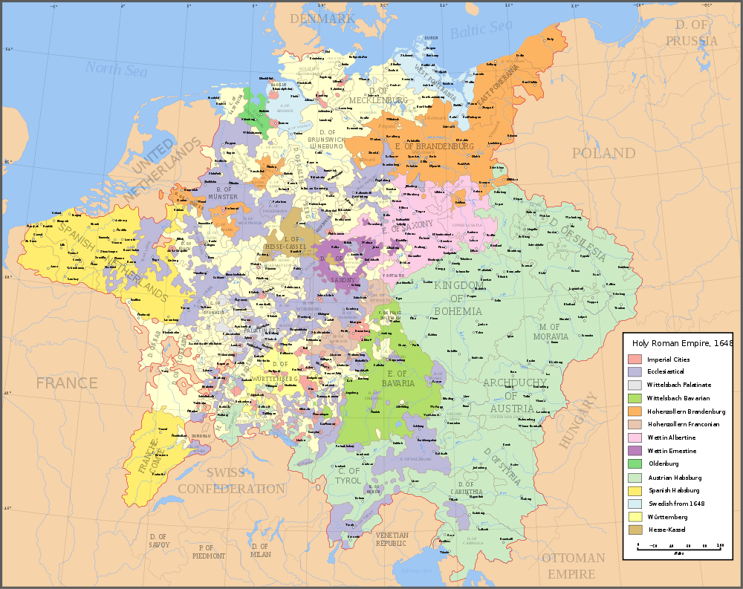
Brandenburg
Map Credit: Astrokey44

Slide 4
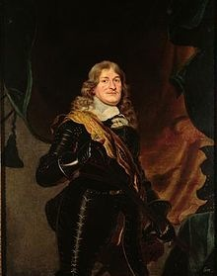
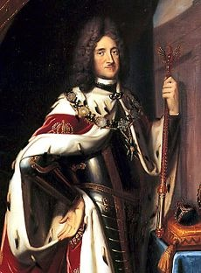
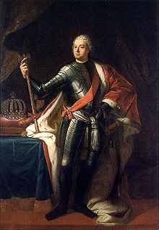
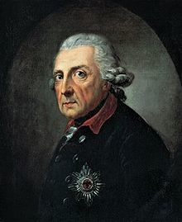
Hohenzollern Dynasty
“The Fredericks”

Slide 5
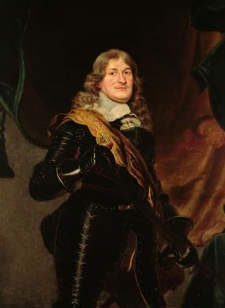
Frederick William
(r. 1640-1688)
The “Great Elector”
Father of Prussian Absolutism
The “Soldier King”

Slide 6
The Junkers
Prussa’s landowning nobility.
The Junkers supported the monarchy and served in the army in exchange for absolute power over their serfs
Led by the Junkers, the officer corps became Prussia’s most prestigious class

Slide 7
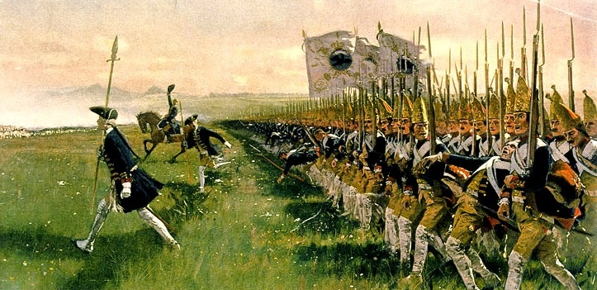
MILITARISM
12TH
Largest Population
4TH
Largest Army
Carl Röchling (d. 1920), Attack of the Prussian Infantry

Slide 8
Peter the Great
Russia

Slide 11
Westernization through
Shipbuilding, education, beard tax,
Western clothes

Slide 12
Classes
Boyars= turned into a service nobility
Streltsy-rebellion

