Slide 1
New Monarchies & Absolutism

Slide 2
Medieval Kings faced many challenges and were constantly “checked” by:
The church
The Nobility
Representative bodies
Towns
Universities

Slide 3
Absolutism the idea or belief that the monarchy has unlimited authority

Slide 4
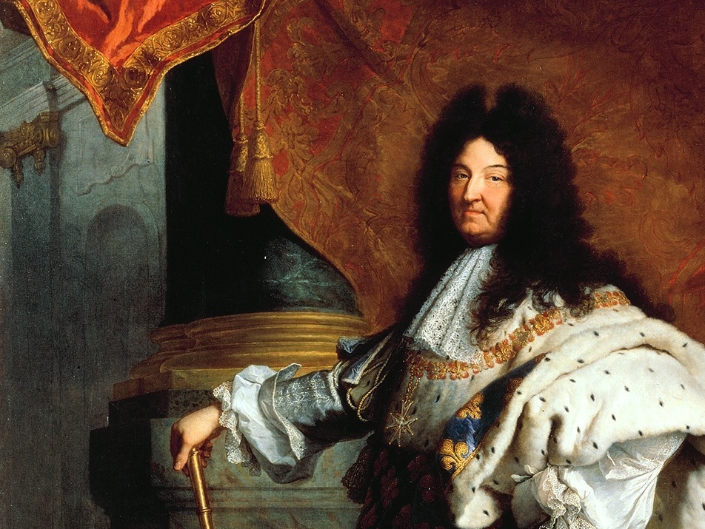
Louis XIV

Slide 5
The Fronde
French for “sling”
French nobles and Parisian townspeople rebelled against Cardinal Mazarin.
Photo by whiteafrican

Slide 6
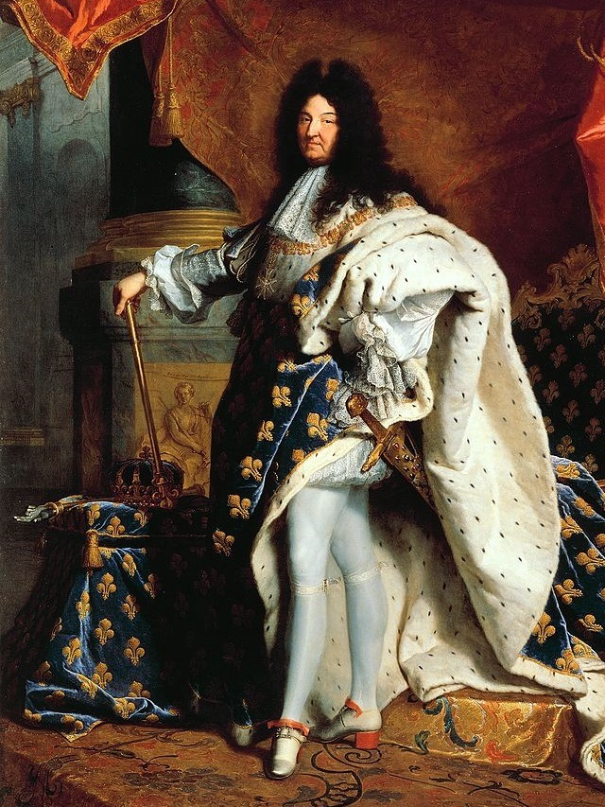
The Sun King
L’etat C’est Moi.
I
am
the State.

Slide 7
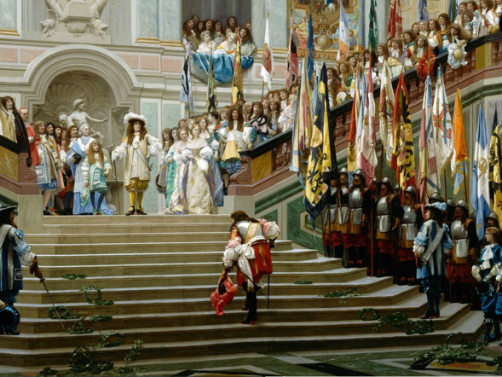
Une Roi
(One King)
Louis put the nobles in their place.

Slide 8
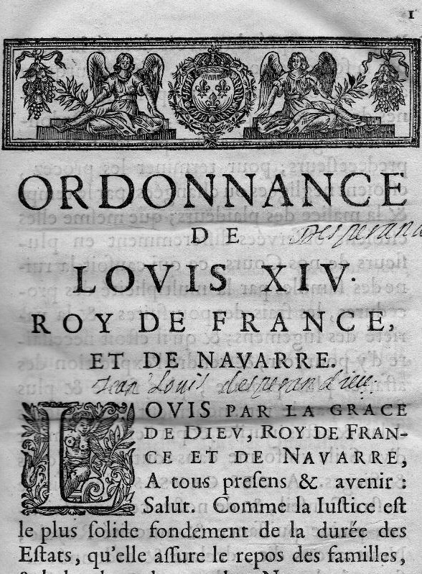
The Code Louis
Une Loi
(One Law)
Louis attempted to standardize the laws in France, which were based on regional customs.

Slide 9
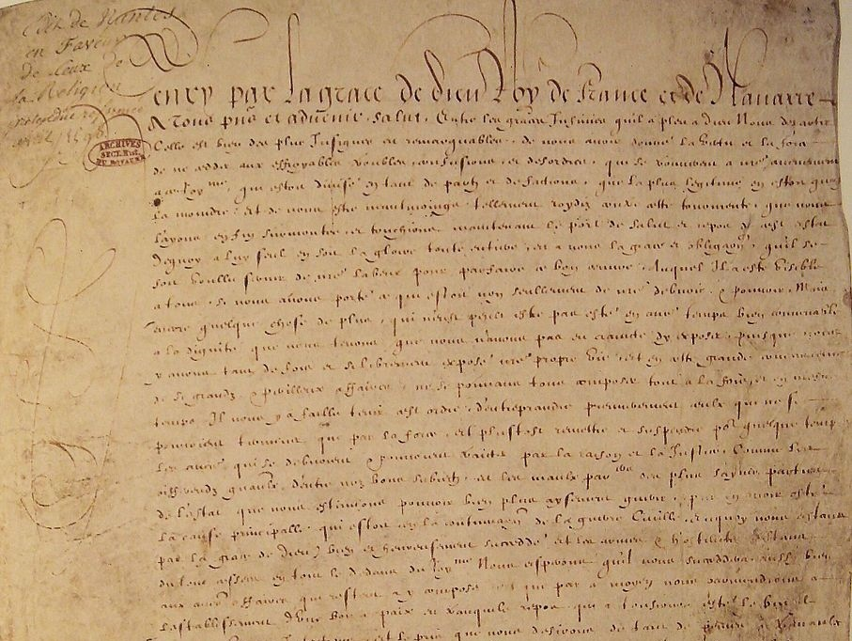
Edict of Nantes
REVOKED
Une Foi
(One Faith)

Slide 10
Wars of
Louis XIV

Slide 15
Treaty of Utrect, 1713
Ended Louis efforts to dominate Europe
Allowed Philip V to remain on the throne of Spain, but stipulated that the crowns of Spain and France should never be worn by the same monarch
granted the Spanish Netherlands to the Austrian Habsburgs
Granted England a number of territories including Newfoundland, Nova Scotia, Gibraltar

